Slide 1

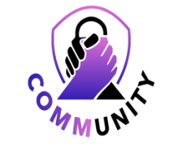
Engaging, Educating & Empowering the community to improve the well-being of children and families. Cobb County partners working together to create opportunities for all people to thrive. Every community has a wide range of needs and Cobb County is no exception. Improving the lives of everyone in a community is a daunting and complex challenge. We partner with organizations and causes to further our mission to improve the well -being of children and families in Cobb County. We focus on our three primary initiative areas of mental health, literacy & civic engagement in order to make the largest impact on our community.
Cobb Literacy Council -

Slide 2
Cobb Collaborative
1314 Church Street,
Smyrna, GA 30080
678-766-5574 / 770-528-8095
Services Open
Monday - Friday
10AM - 2PM
https://www.cobbcollaborative.org/
Contact Us -

