Slide 1


T.R.I.A.G.E.
Tactical Response In Aiding God’s Endangered
Helping the ones in need -

Slide 2
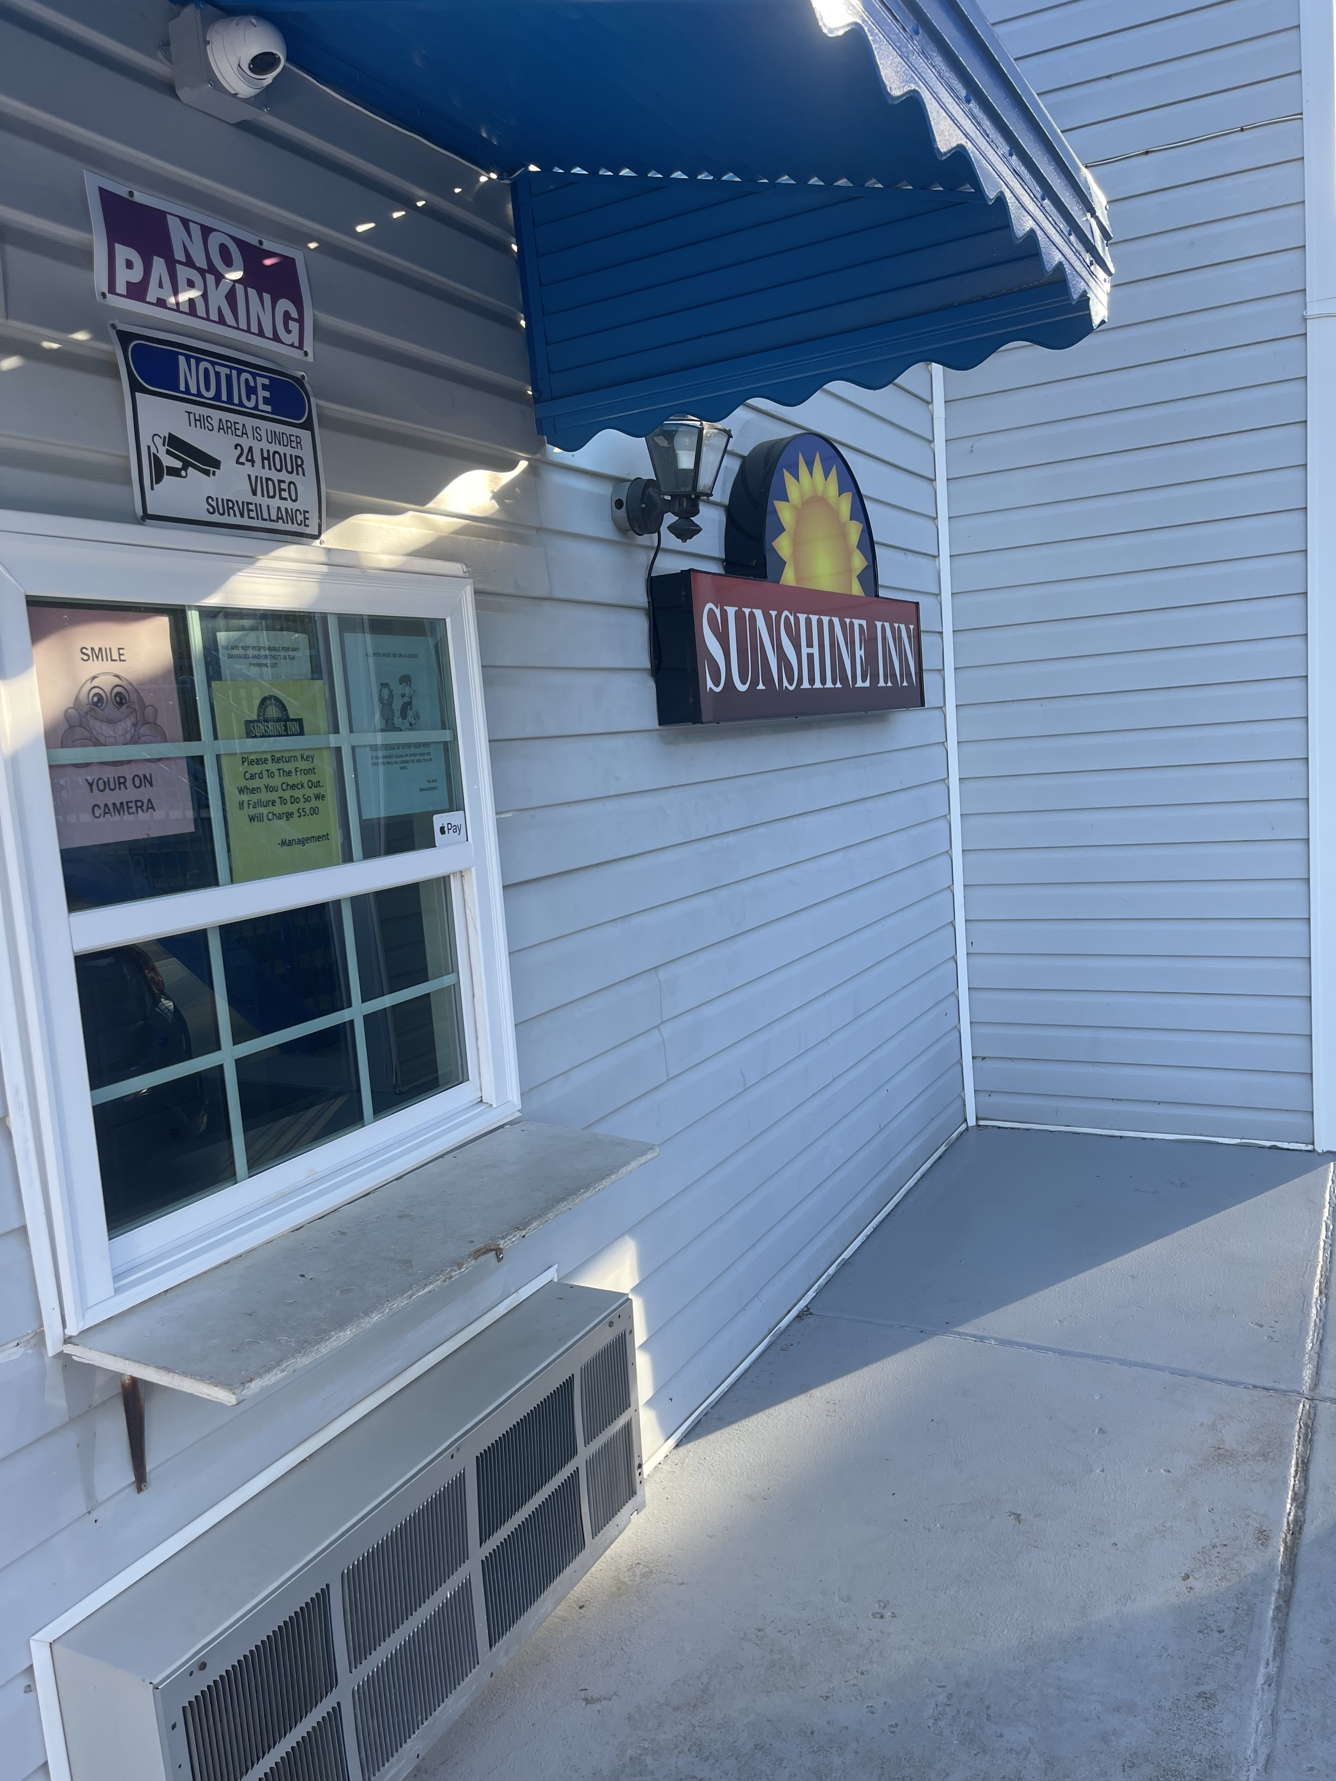
Our Inaugural Outreach Visit -

Slide 3

Our 1st Outreach Event Flyer -

Slide 4

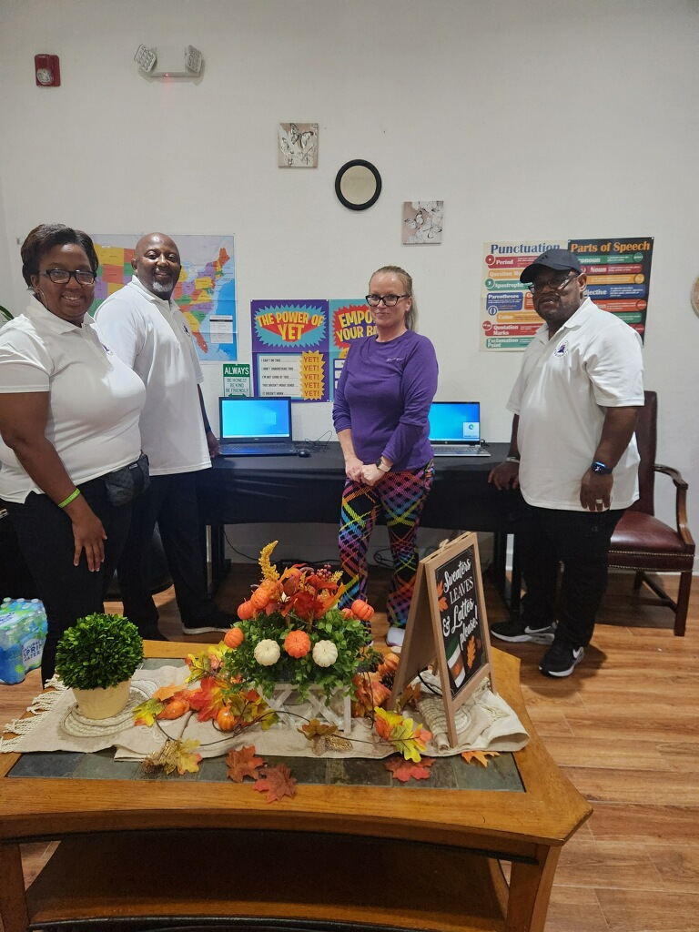
Thanks to COMMUNITY for their help in creating a resources center for the people at Sunshine Inn.
Outreach 1st Visit -

Slide 5
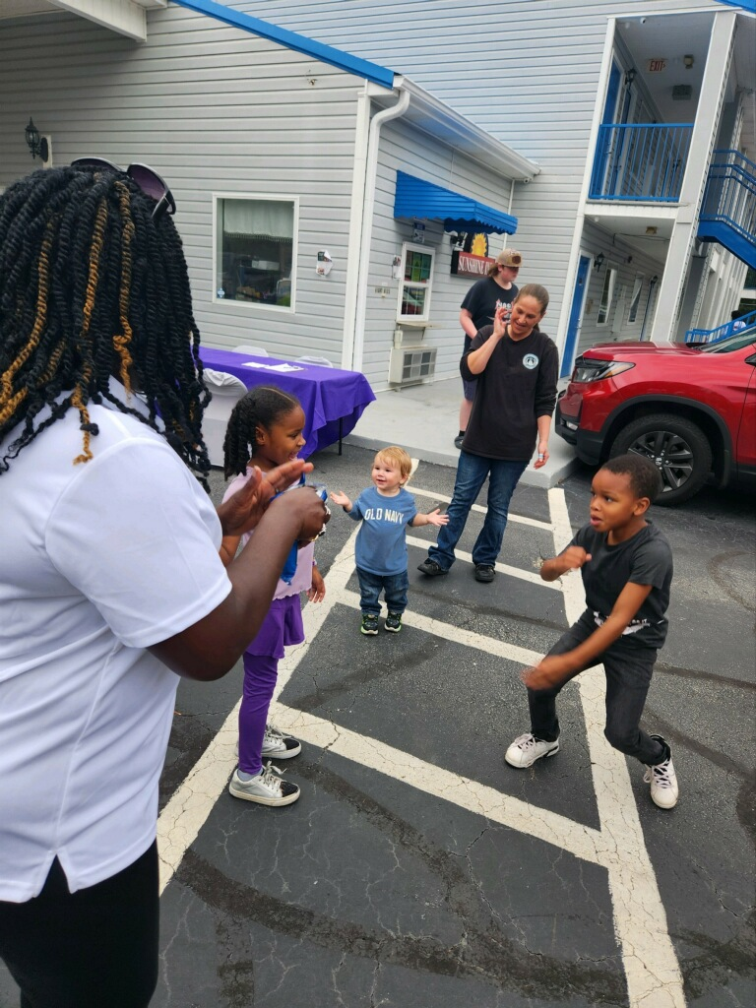
Great times created at Sunshine Inn
Outreach 1st Visit -

Slide 6
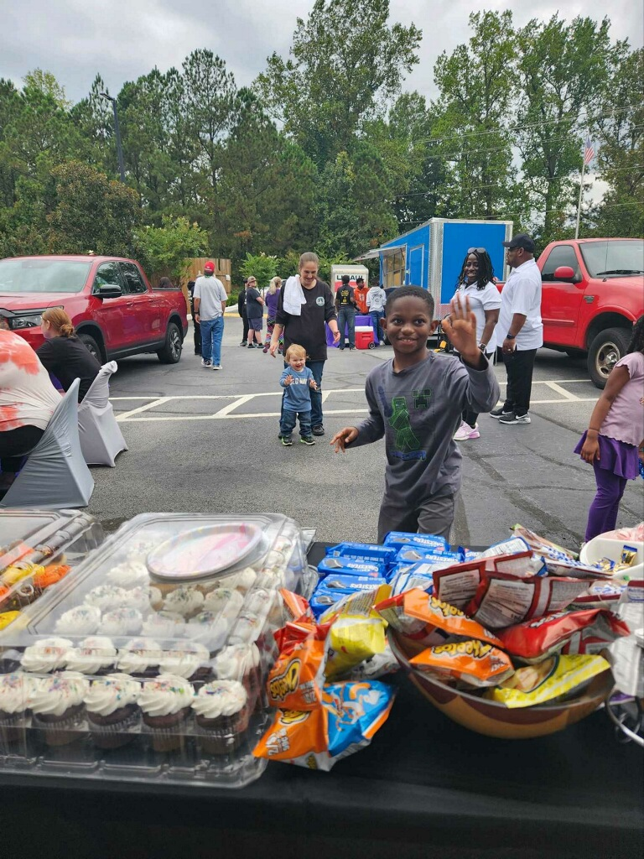
Taking care of the families and kids are all
part of our during our outreach events
Outreach 1st Visit -

Slide 7
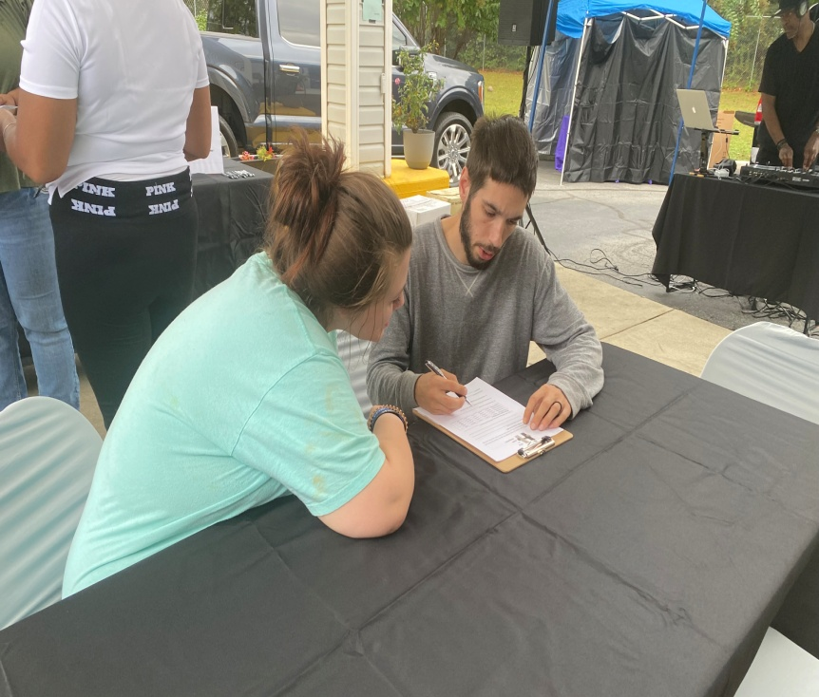
Part of our program is we have families fill out our HUGS card.
Its helps us gather information, so we can help out families with basics needs.
Outreach 1st Visit -

Slide 8
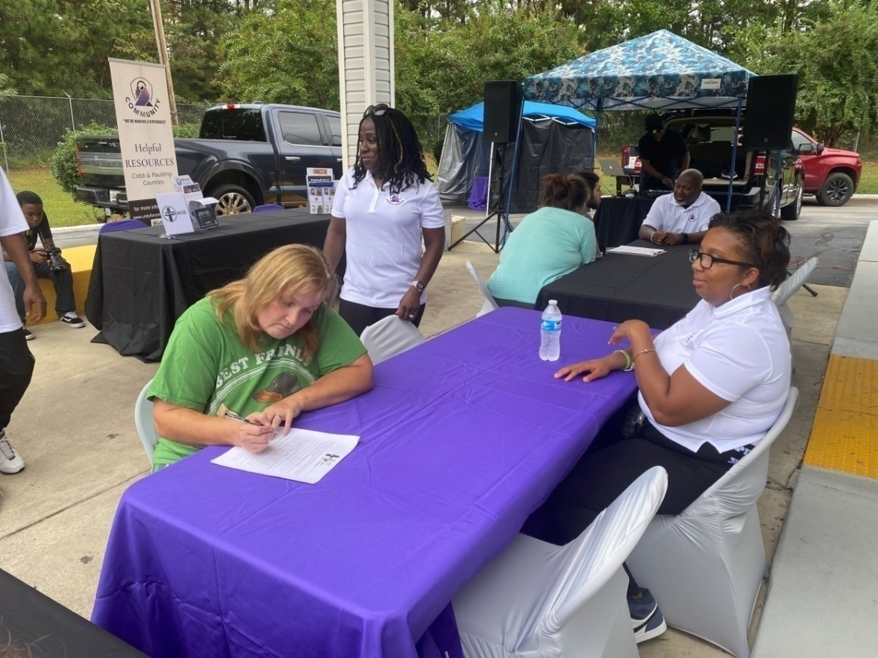
Our staff assist with counseling, pray, and guidance, as we start the
process of helping people get back on the road to a better way of life.
Outreach 1st Visit -

Slide 9
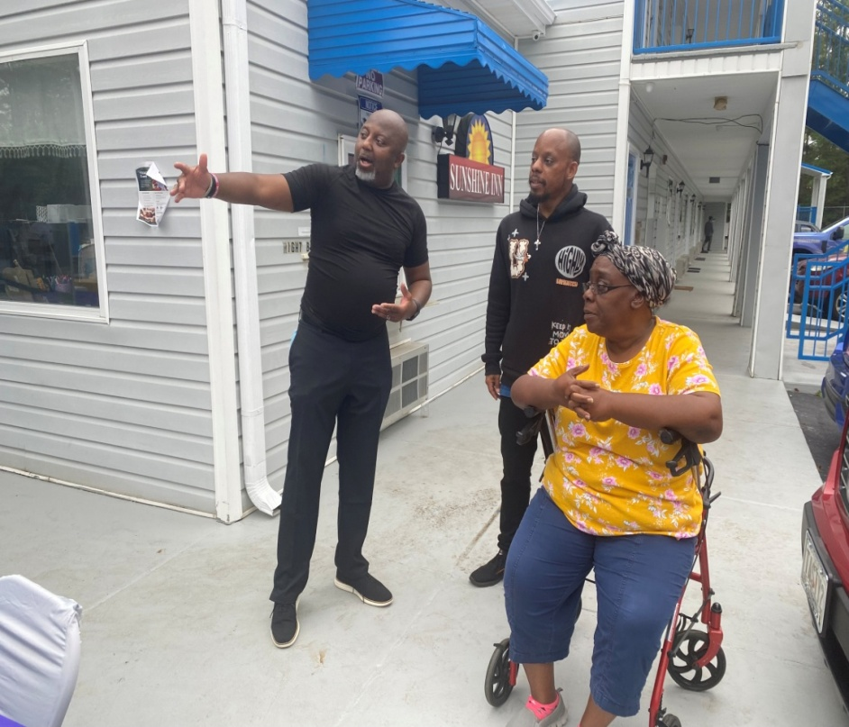
Our President & CEO, Phil Davis leads the
charge and our outreach program.
Outreach 1st Visit -

Slide 10
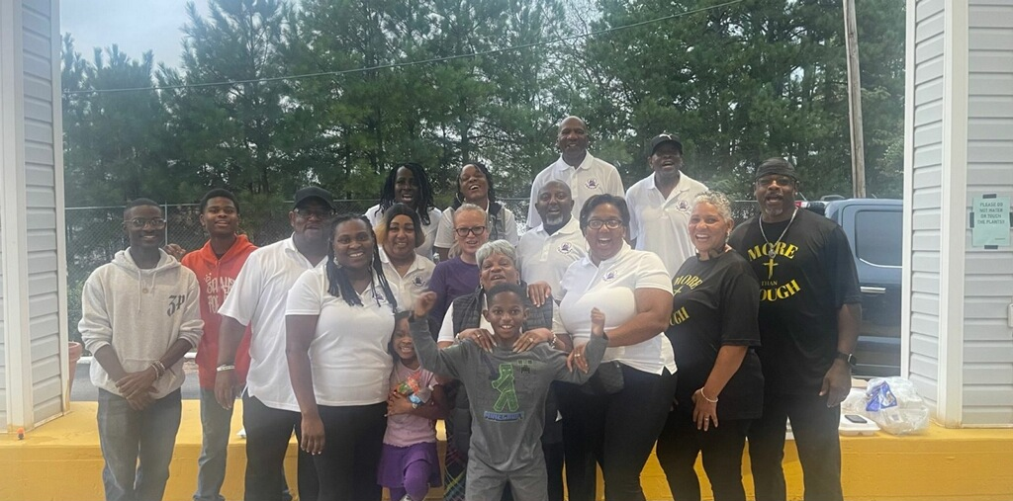
Our Connect Group continues to shine & pave the way in the community. We want
to thank Always Enough for their support during our first Outreach Event!
Outreach 1st Visit -

Slide 11
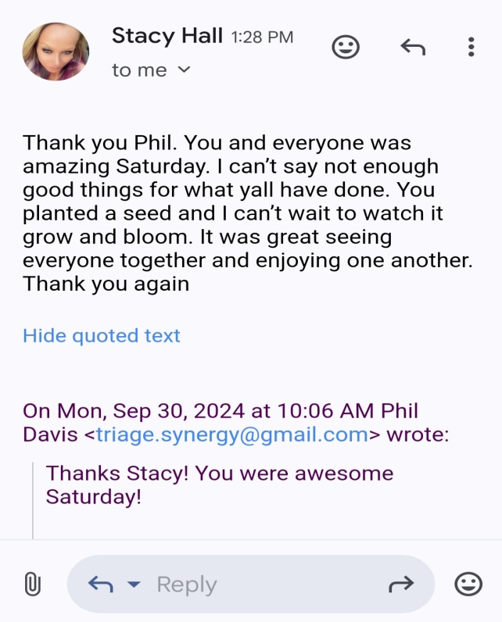
Our 1st Resource Center -

