Slide 1


T.R.I.A.G.E.
Tactical Response In Aiding God’s Endangered
Helping the ones in need -

Slide 2
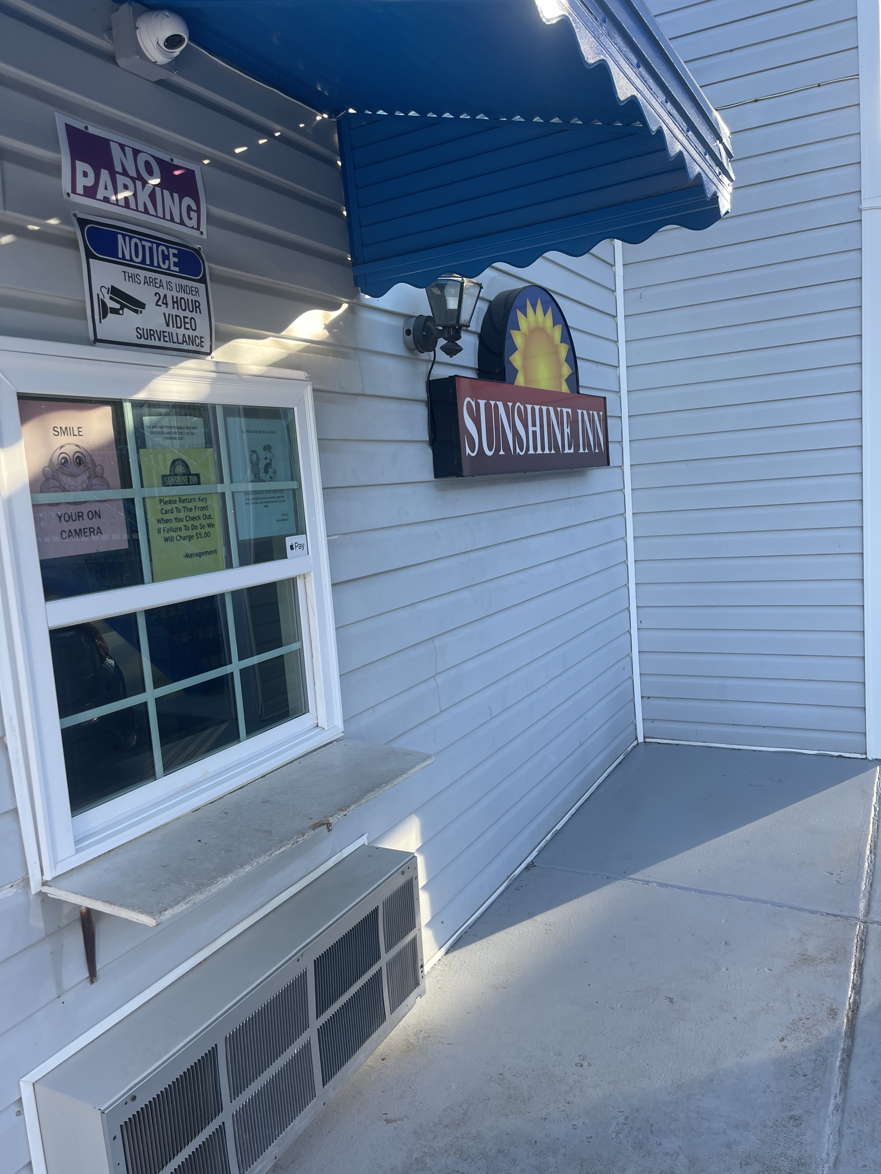
Outreach 2nd Visit -

Slide 3

Our 2nd Outreach Event Flyer -

Slide 4
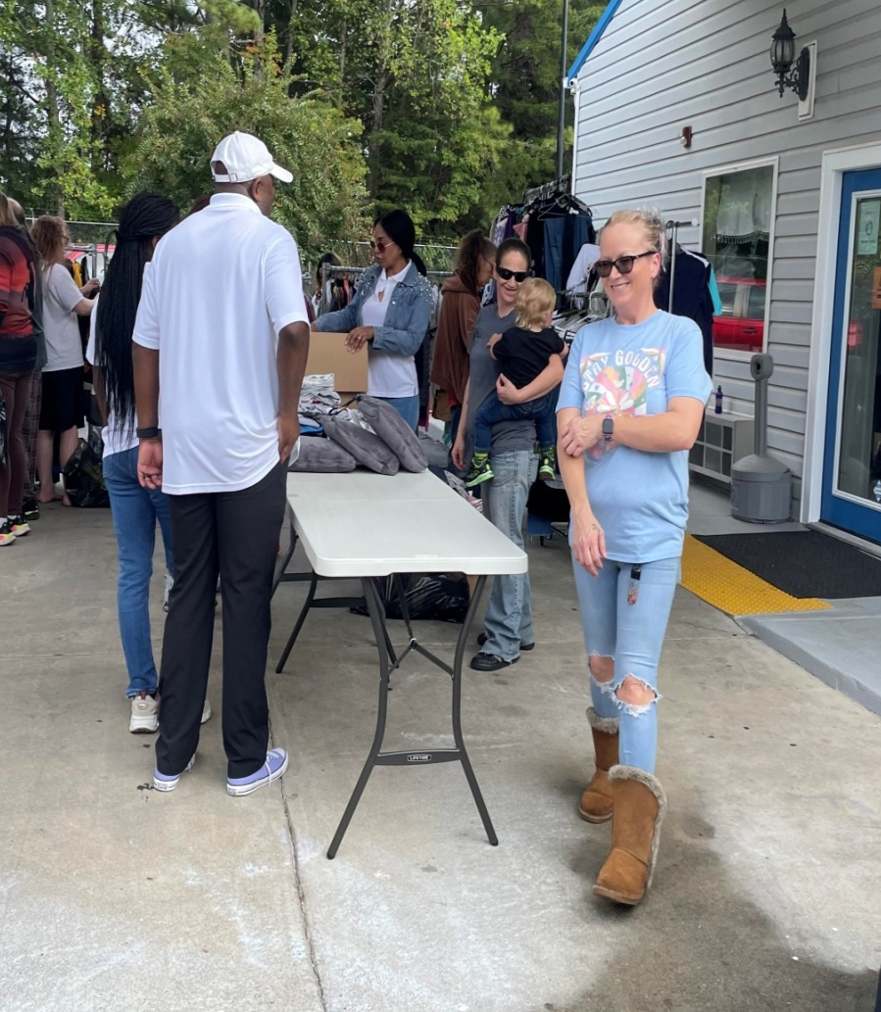
Let’s Get it Starts!
It’s always great to see smiles on the faces on the group @ Sunshine Inn. We’re so grateful for Stacy Hall, the site manager for allowing us to help the ones in needs. This has been and will continues to be a great partnership!
Sunshine Inn Manager -

Slide 5
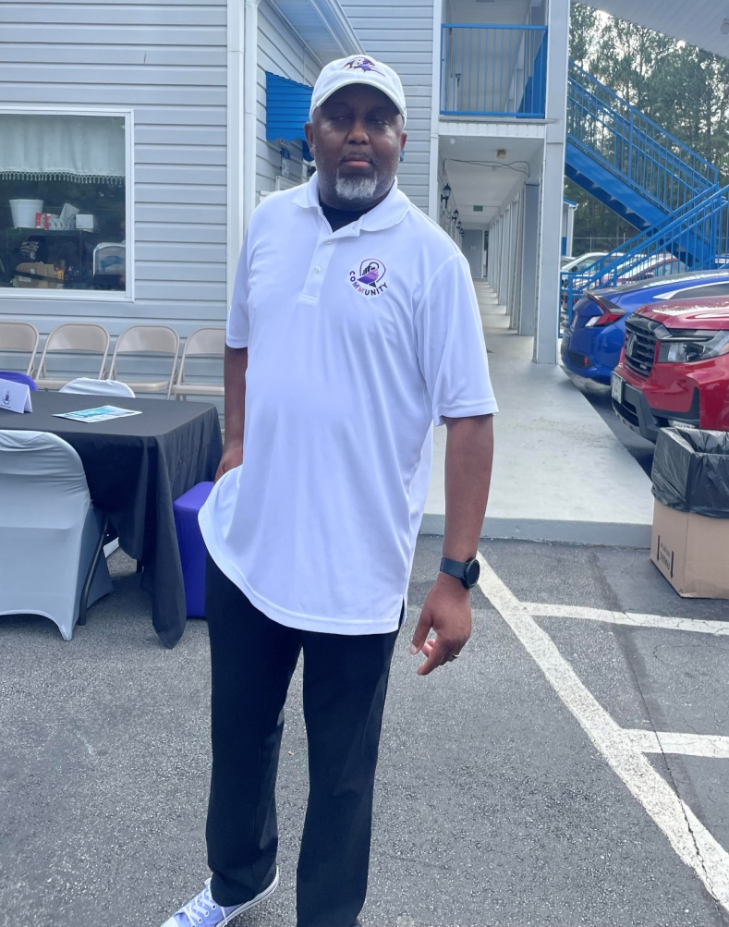
The mission and the foundation has been set! Thanks to our President & CEO, Phil Davis. TRIAGE is growing and with Phil’s leadership, will we continue to provide services to the ones in need.
Our President & CEO -

Slide 6
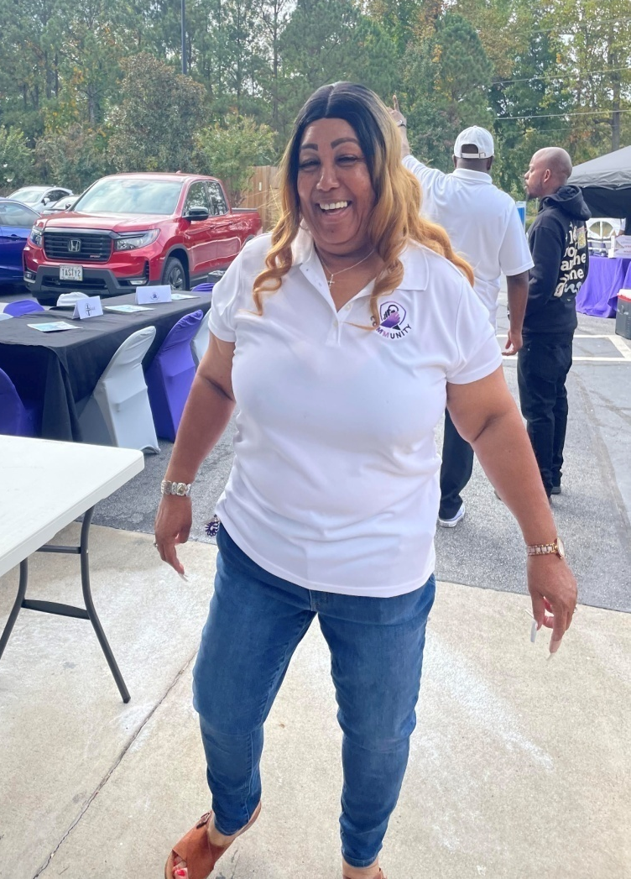
Bringing the fun and excitement to the cause! That what serving is all about! Where here to help the ones in need. Ready, willing, and surely able!
Outreach 2nd Visit -

Slide 7
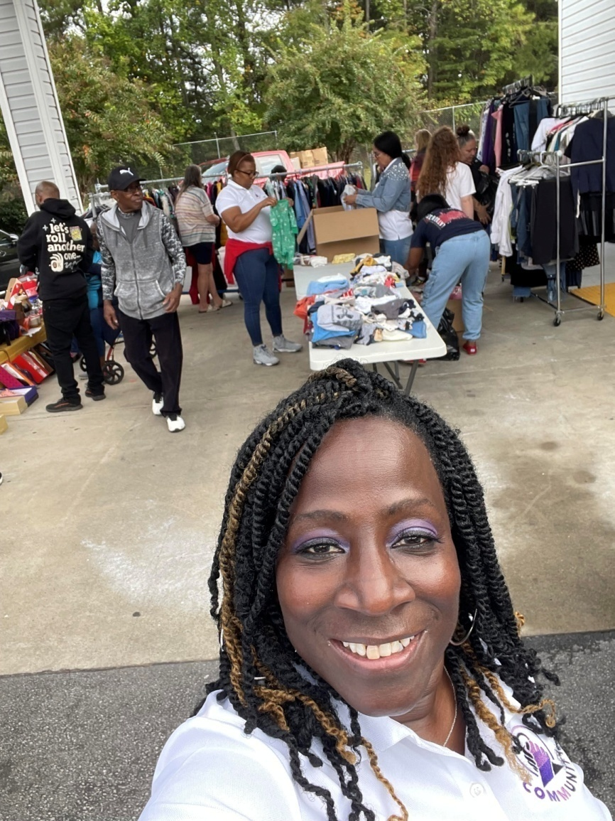
It’s starts with a vision and a purpose. There nothing like the feeling of giving back to the ones that need it the most. Our clothing drive was a huge success due to the team’s willingness to give up the most important thing in their lives, Time!
Outreach 2nd Visit -

Slide 8
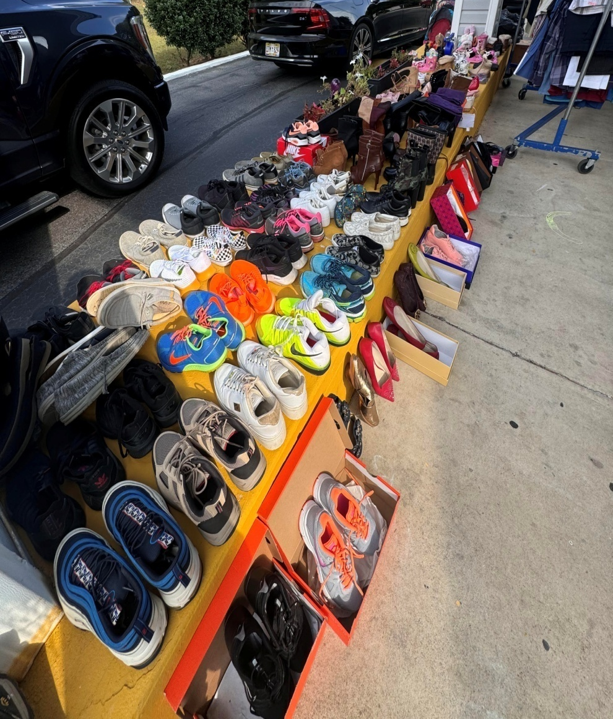
Our organization wants to thank our community for donating all of the clothing for our clothing drive. With the help of our HUGS Cards that we distribute at our first outreach visit, we were able to fulfill a lot of the group’s needs. We had a great selection of shoes.
Outreach 2nd Visit -

Slide 9
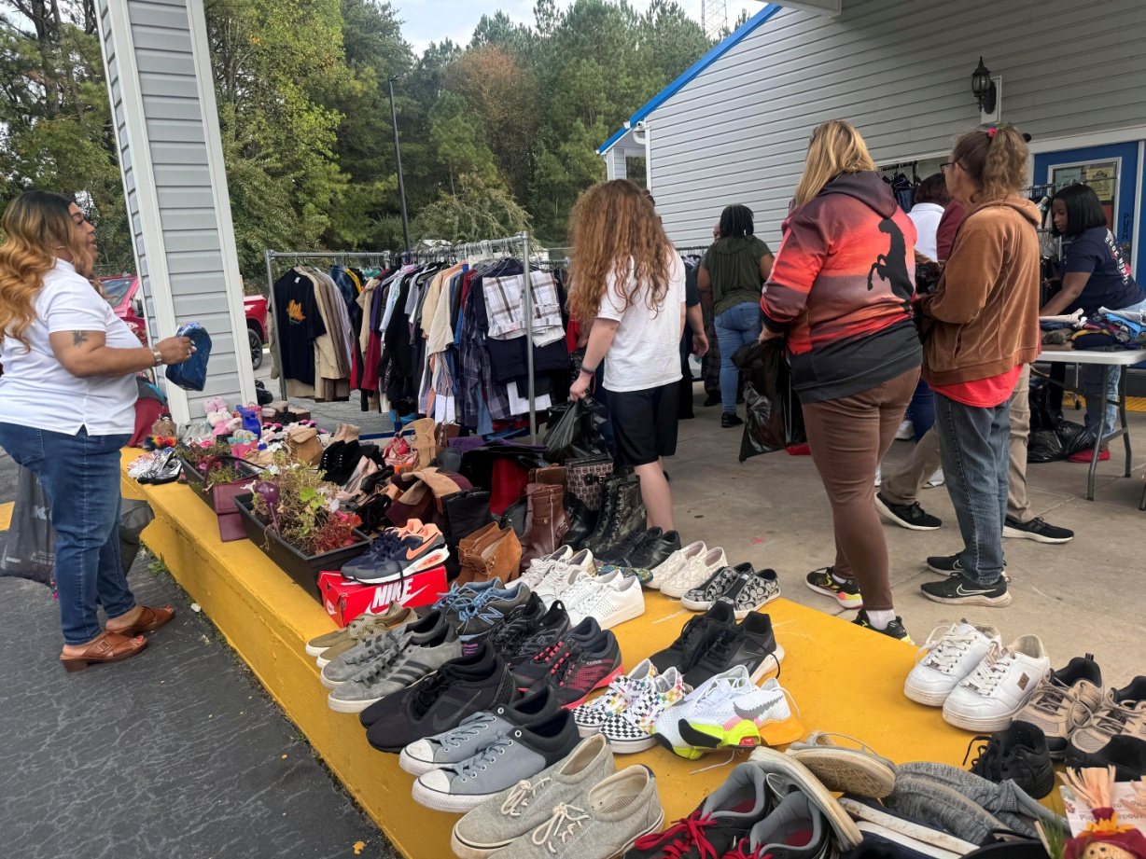
Something for everyone at the TRIAGE event! Again, we thank the community for donating to the cause.
Outreach 2nd Visit -

Slide 10
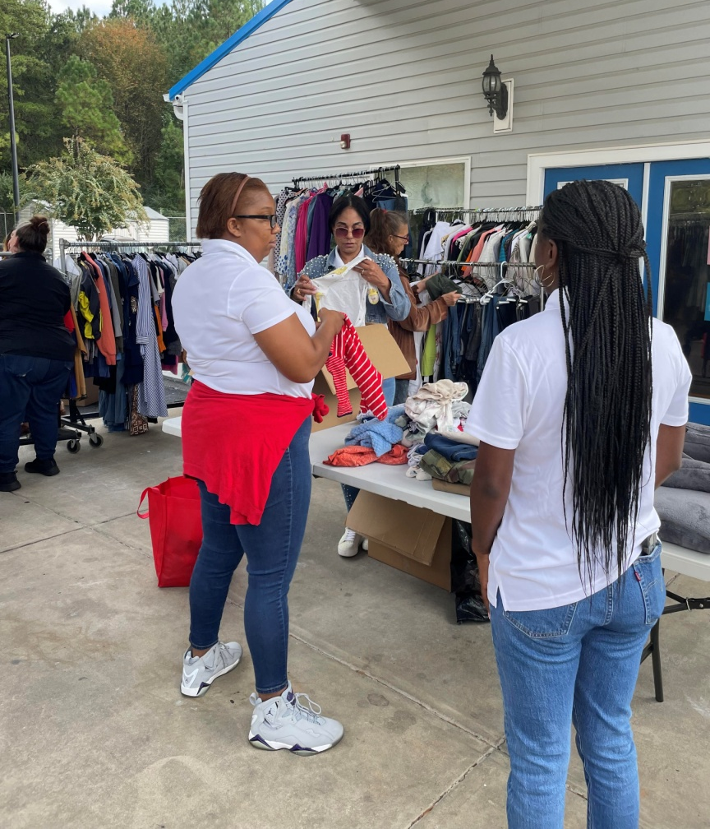
We want to again thank the COMMUNITY Group for all their efforts to make this event a success.
Outreach 2nd Visit -

Slide 11
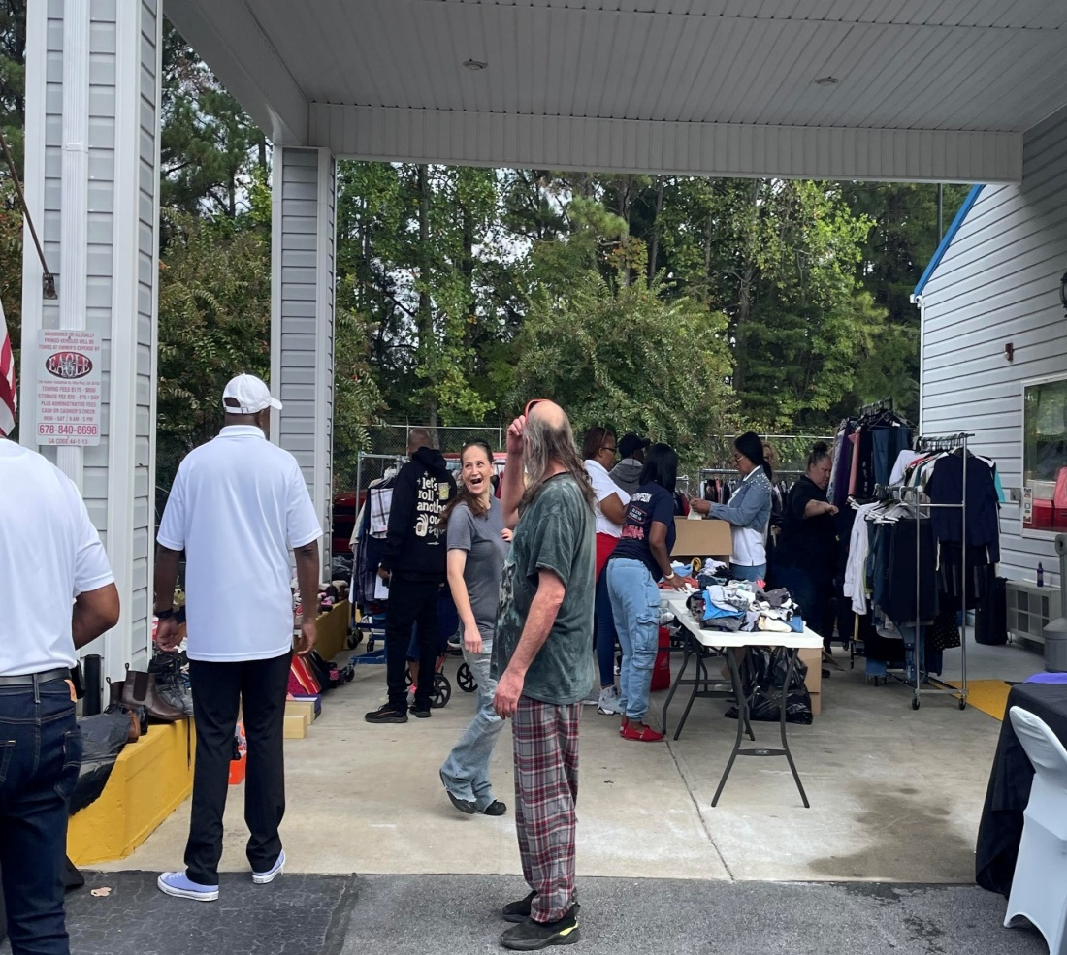
Helping people is the standard! COMMUNITY and TRIAGE are setting the standard one day at a time.
Outreach 2nd Visit -

Slide 12
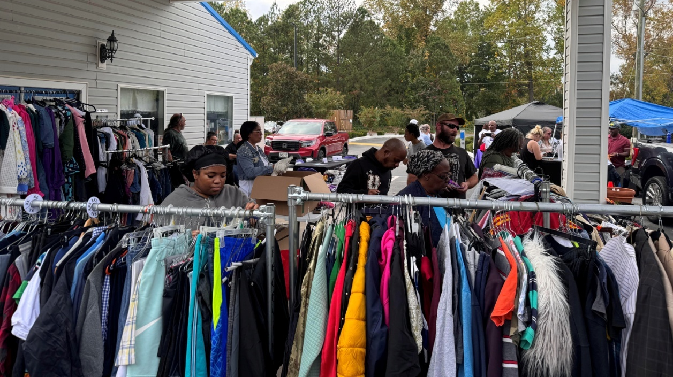
Over $20,000 in clothing was donated by the local community to the help cause! Thank again to all our teammates who took the time to set a positive and successful event!
Outreach 2nd Visit -

Slide 13
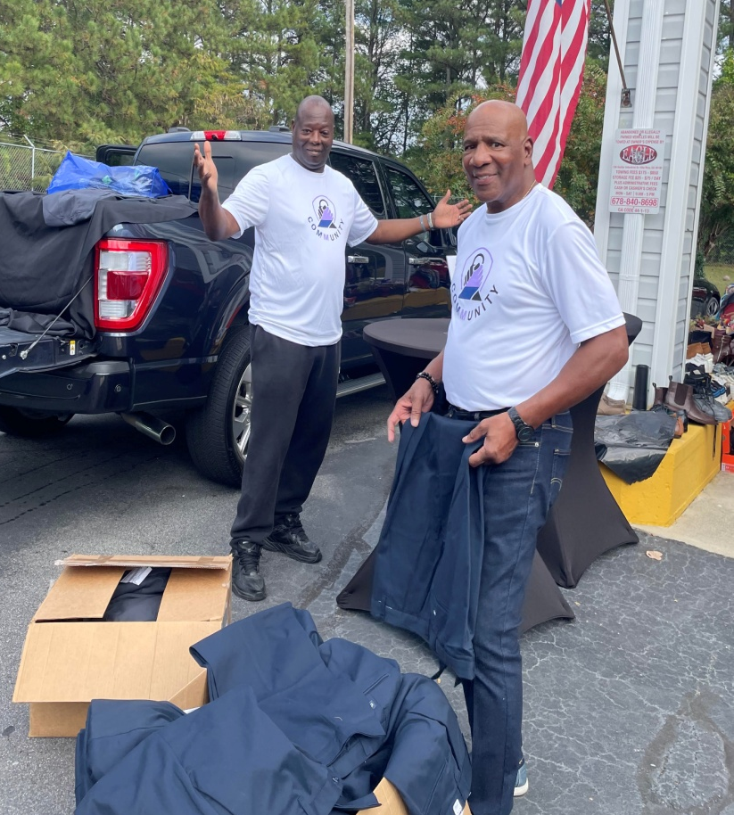
At TRIAGE and COMMUNITY it’s all about the work! Coordination and organization is a must in order to put on a great event! You have to love what you do!
Outreach 2nd Visit -

Slide 14
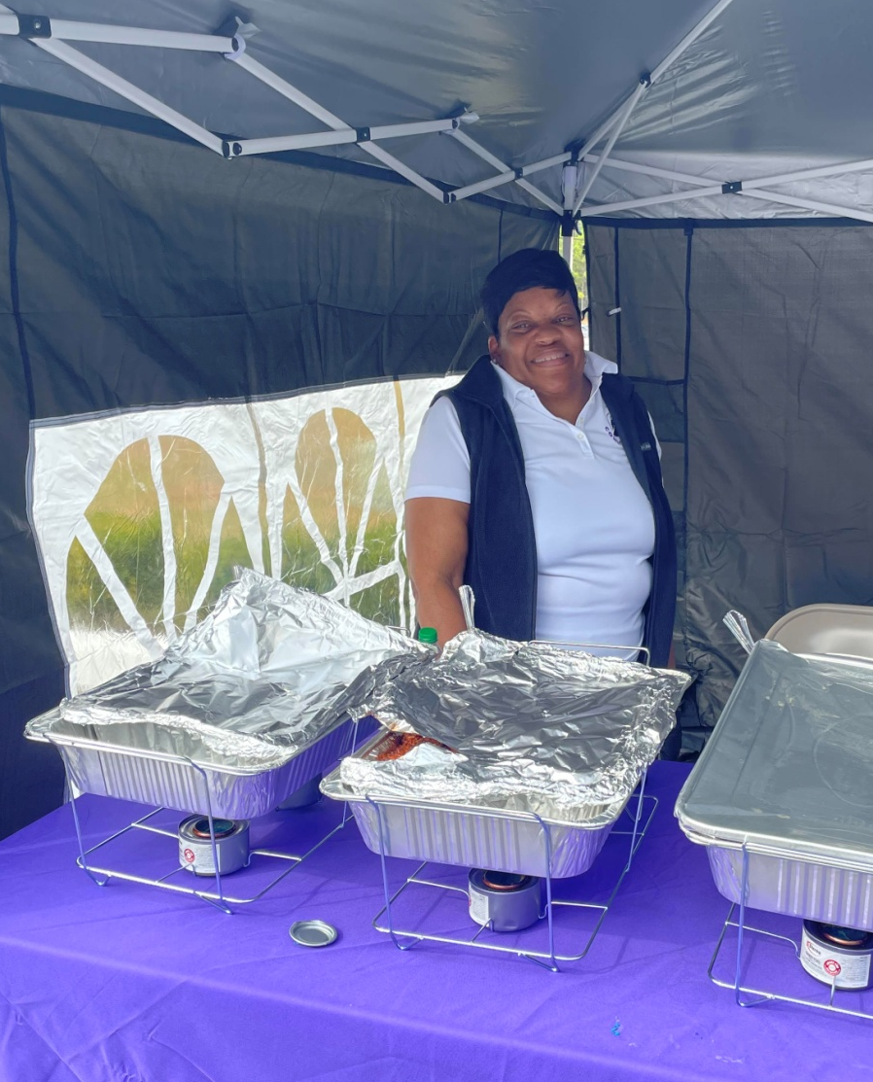
Our hospitality outreach team looks to provide great food for all the people that attend our event. We want to thank Ingles Supermarket for providing food for this event.
Outreach 2nd Visit -

Slide 15
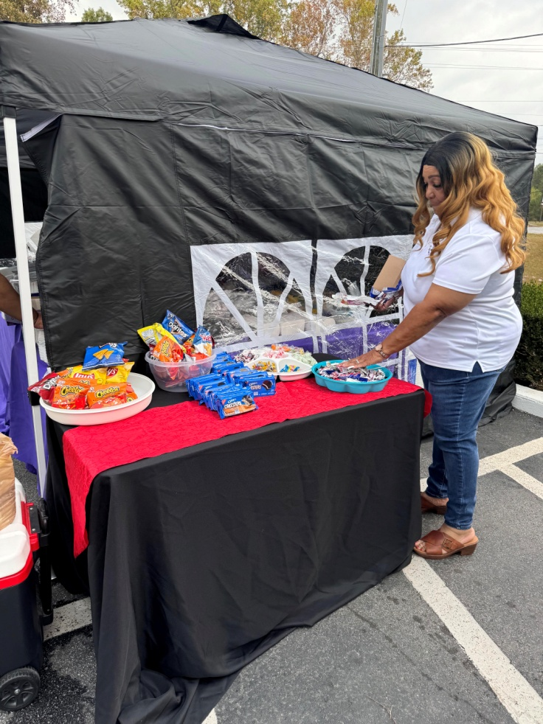
It’s take time and pride to be successful and our team continue to show their greatness. Helping others is a huge part of the mission at TRIAGE
Outreach 2nd Visit -

Slide 16
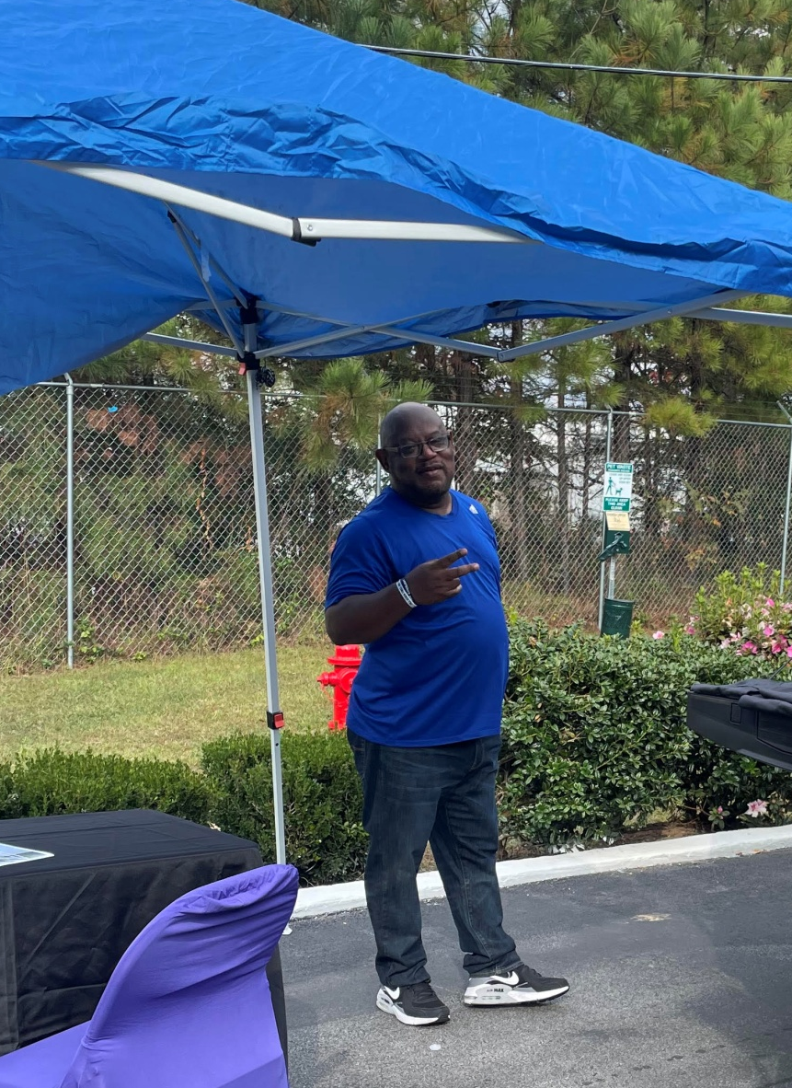
There nothing like have a happy leader after a outreach event! Where so happy to have COMMUNITY’s partnership at all of our outreach events, thanks Rick for your support and guidance.
COMMUNITY’s Preisdent -

Slide 17
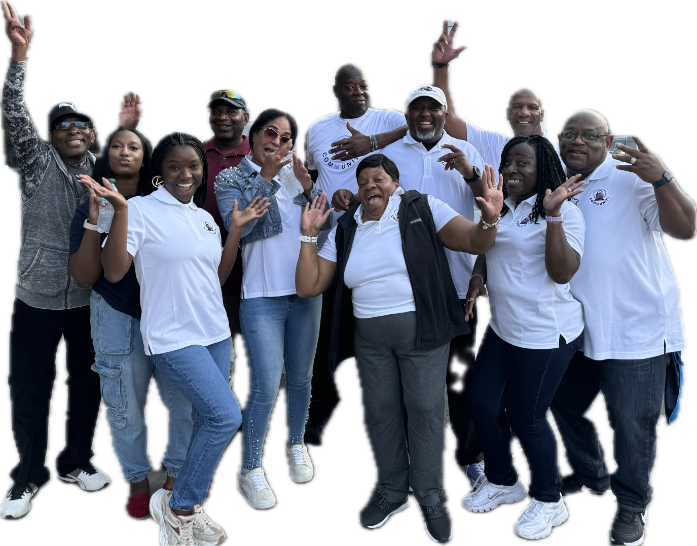
Just having fun giving back to the one in need! As our Pastor said “Let’s Go!
Outreach 2nd Visit -

Slide 18
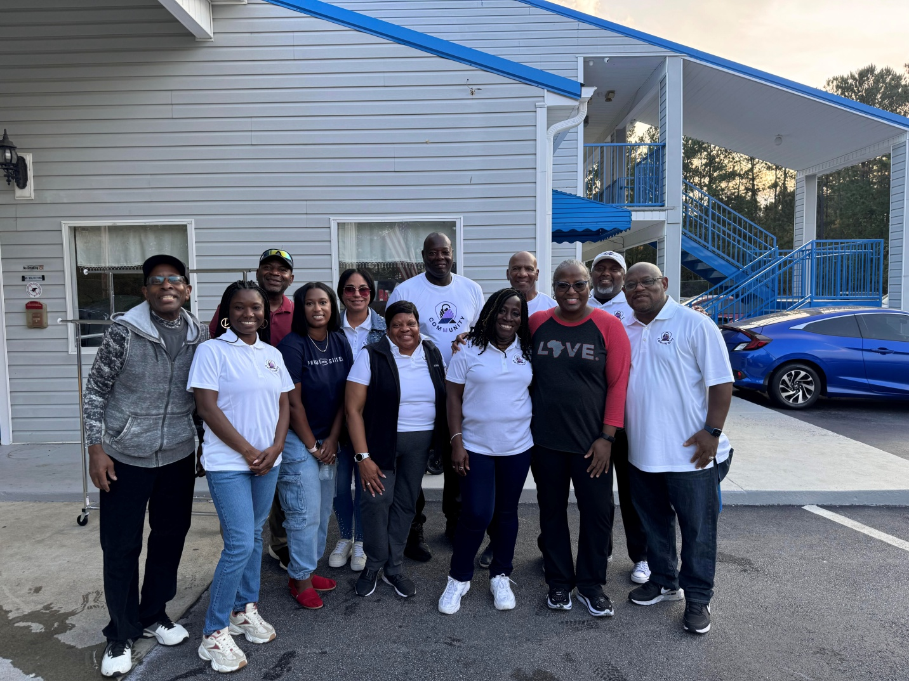
We were so happy to have a member from our church leadership (Linked UP) come out to support of mission in the community. Thanks, Minister Kimberly for all your support to TRIAGE and COMMUNITY!
Outreach 2nd Visit -

