Slide 1


T.R.I.A.G.E.
Tactical Response In Aiding God’s Endangered
Helping the ones in need -

Slide 2
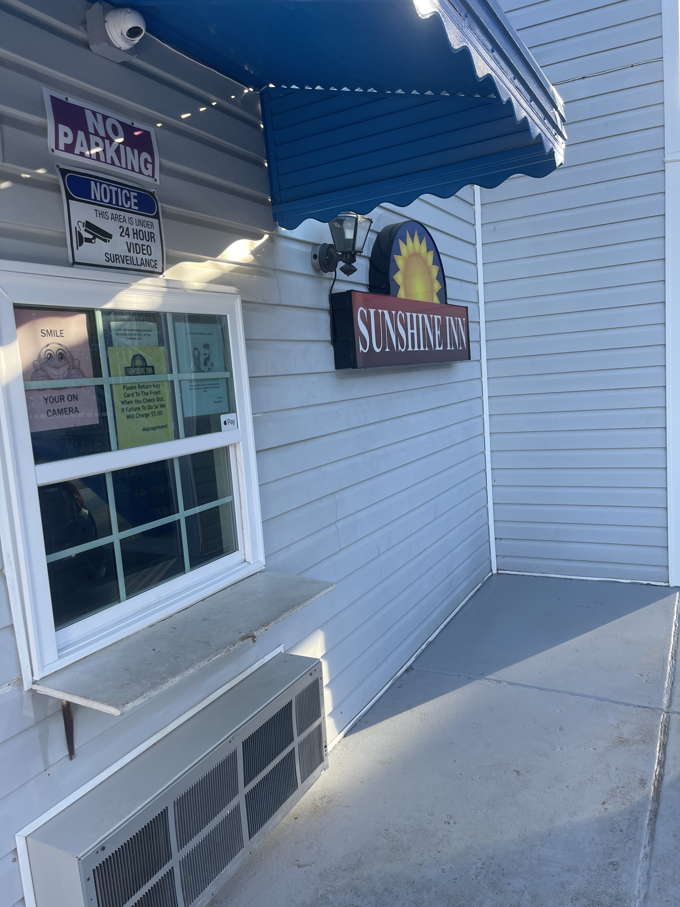
Our 3rd Outreach Visit -

Slide 3

Outreach 3rd Visit -

Slide 4
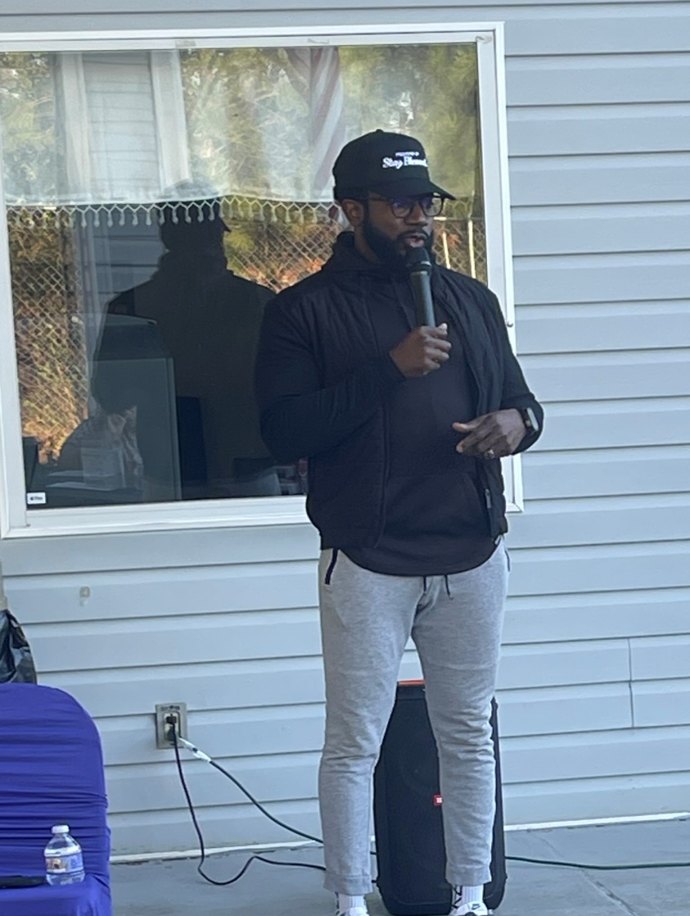
We had the privileged to have Desmond McCain to speak to our family members at Sunshine Inn. Desmond spoke on the importance of financial health, saving opportunities, as well as given guidance on handle personal hardships.
Financial Health -

Slide 5
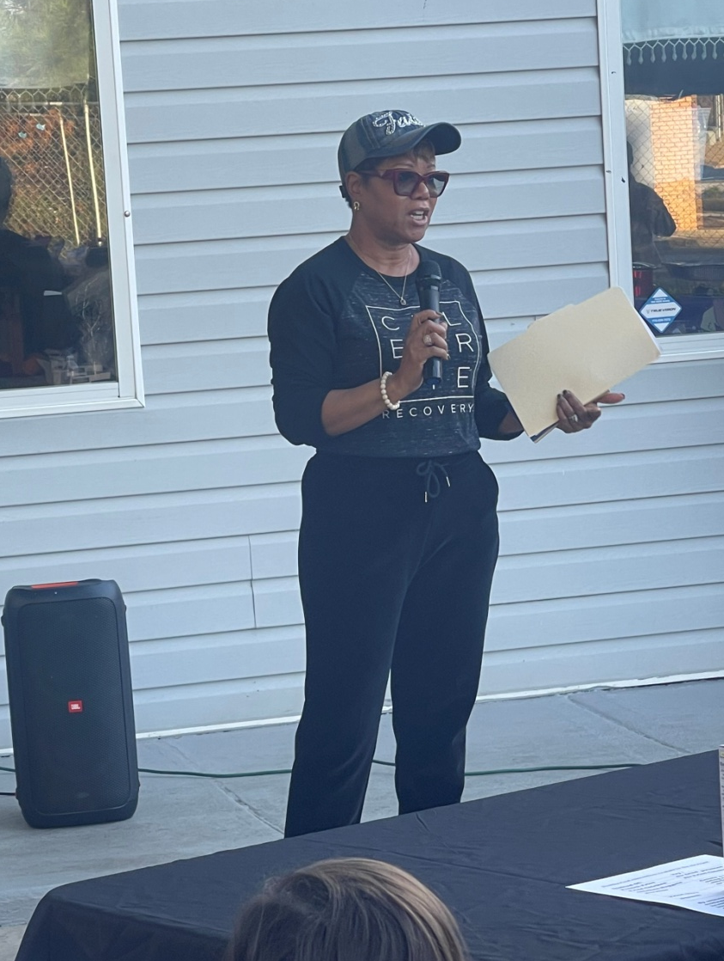
Kim Arrington, a renown speaker within the community spoke on recovering from drug and alcohol addiction. Kim gave encouragement and resources on how to seek the road to recovery.
Drug & Alcohol Recovery -

Slide 6
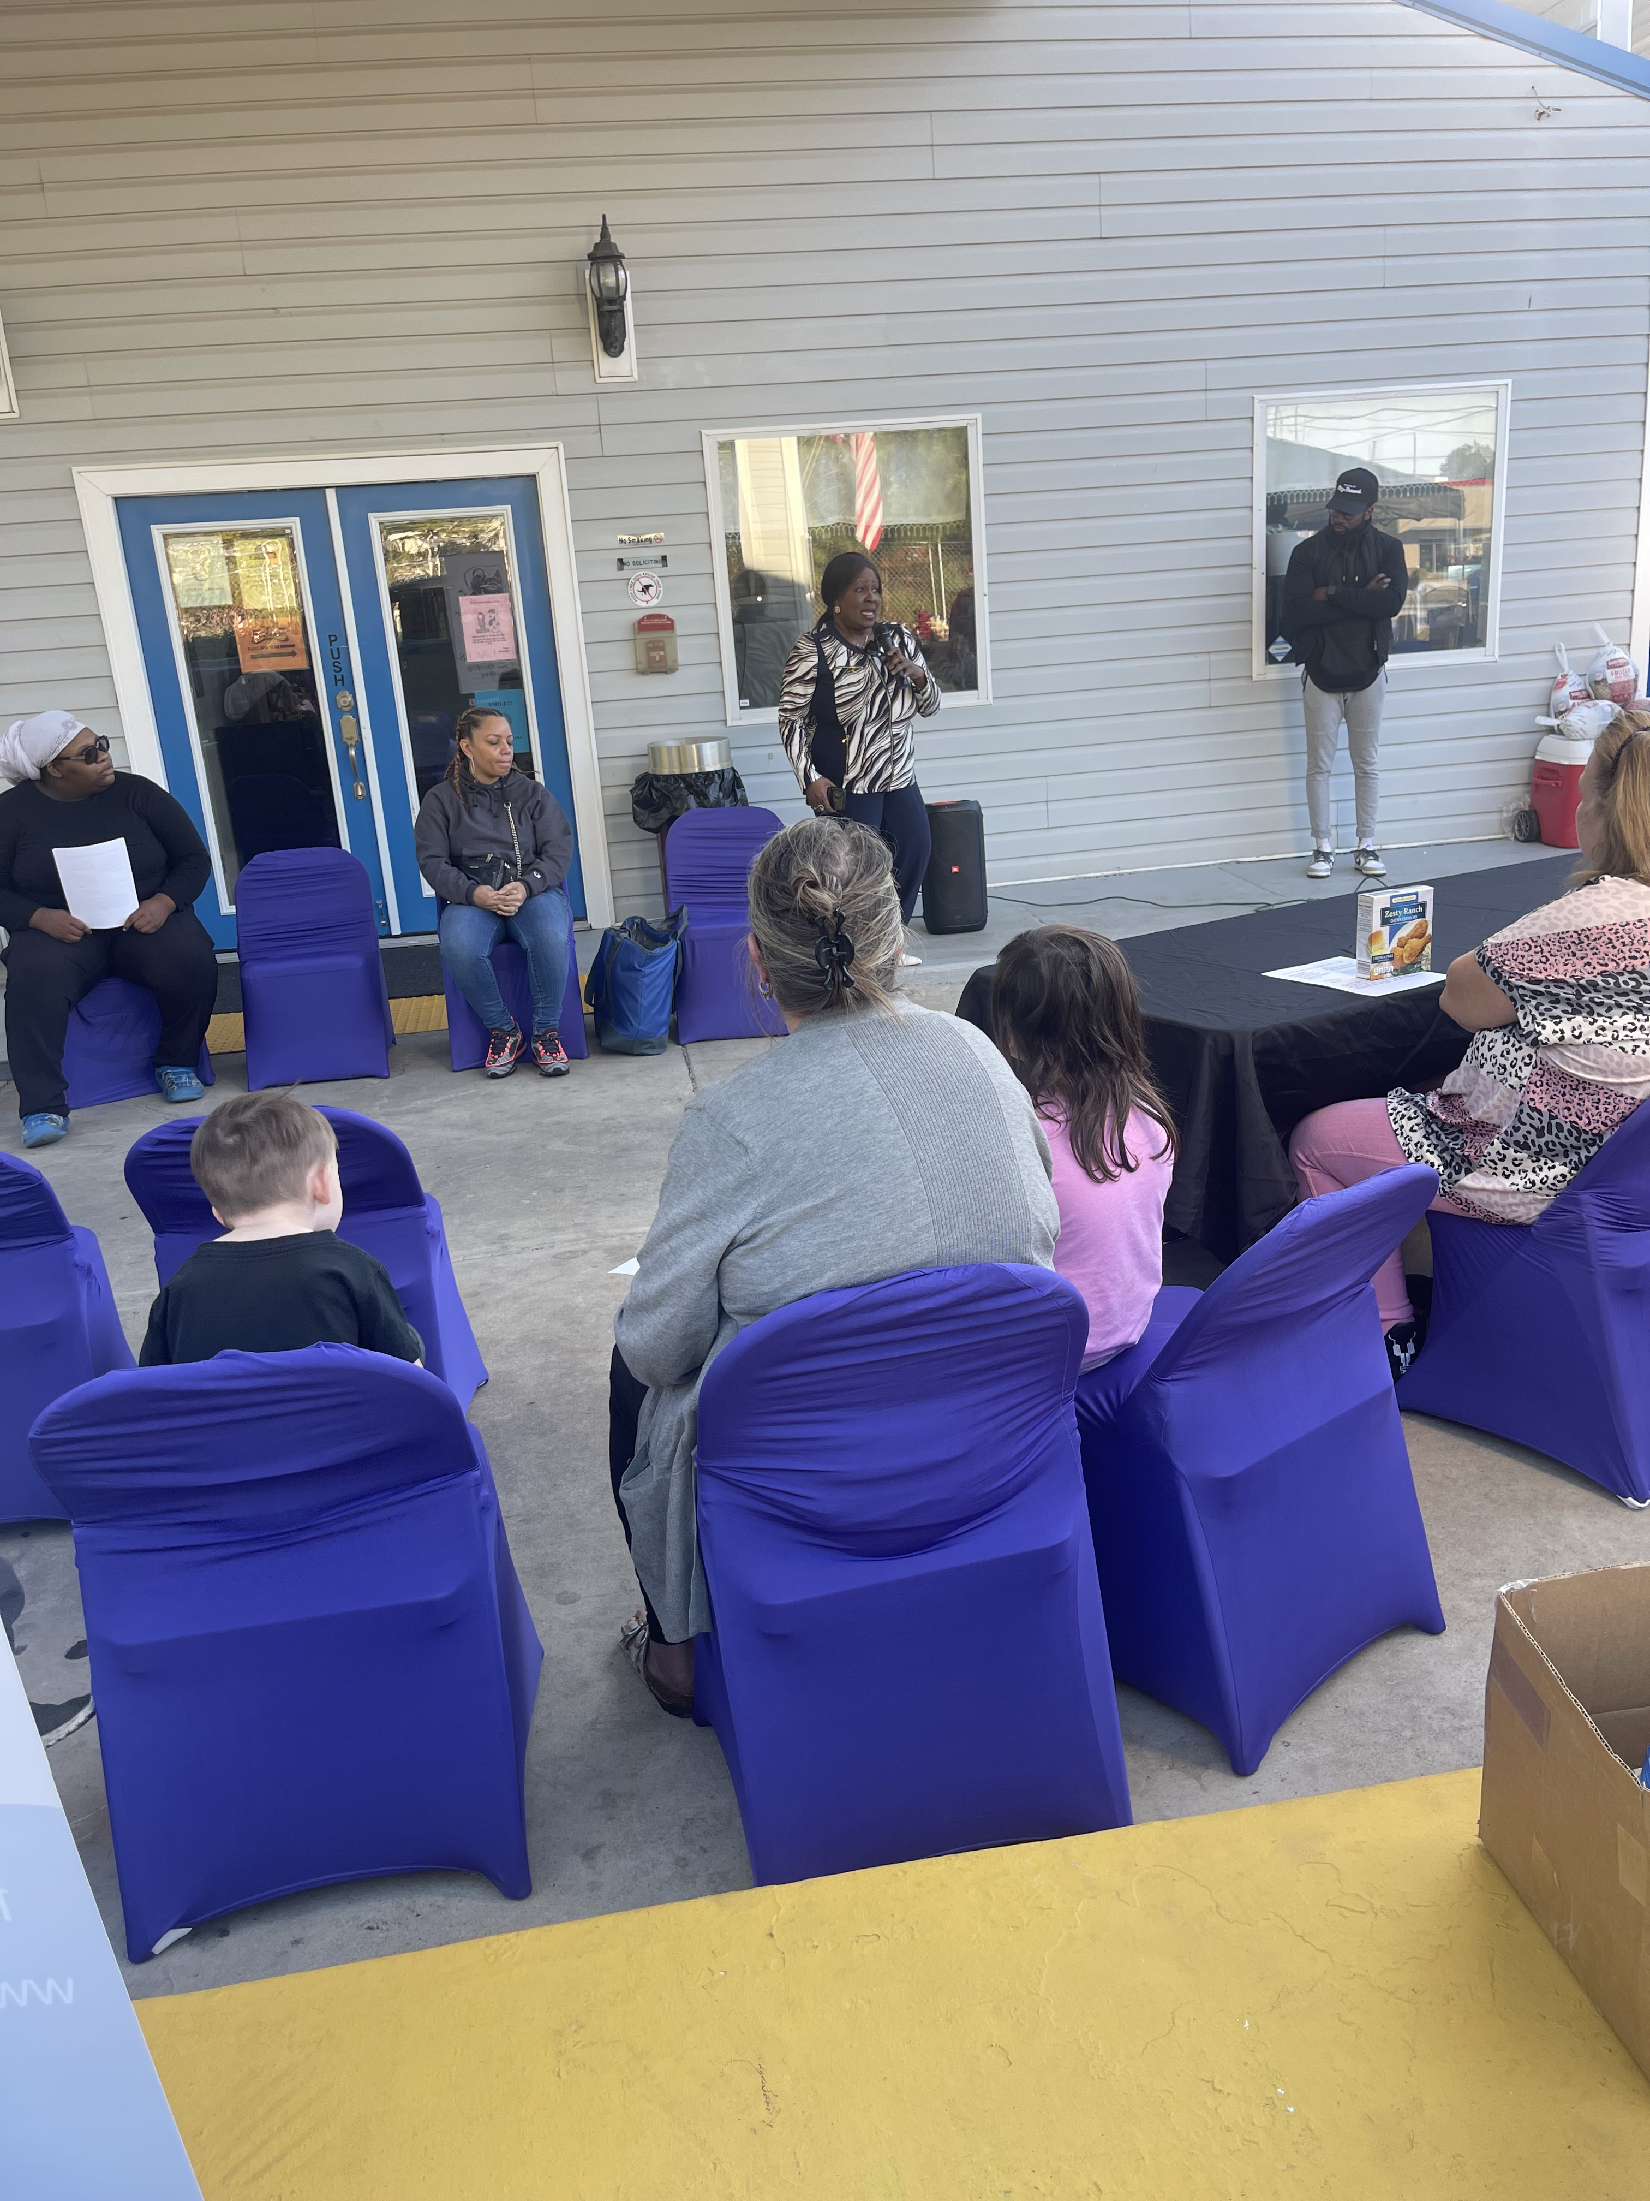
Mental Health is a major problem in our country and we were so honored to have Michelle Blunt, an advocate and advisor to speak to our group. Michelle gave a dynamic speech on this issue.
Mental Health -

Slide 7
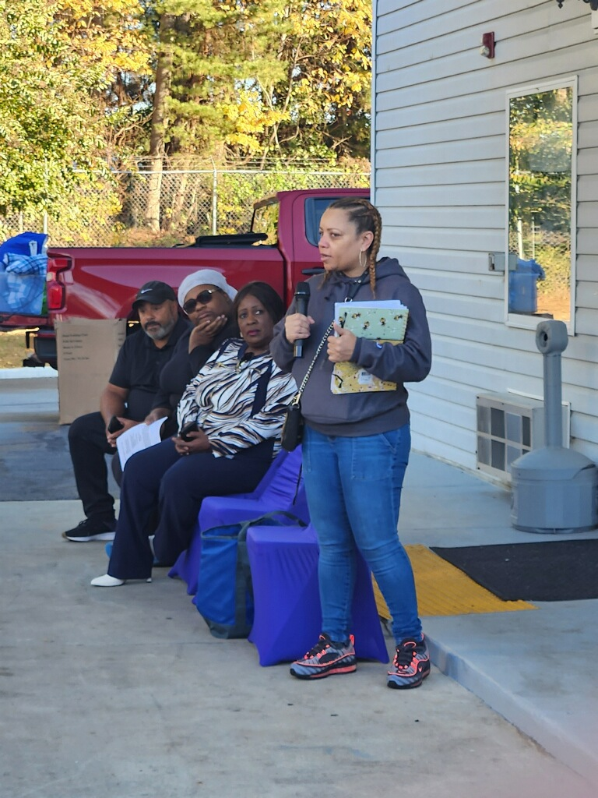
Physical movement plays a huge part in our day – to – day lives. Beatrice Gray, a well known speaker and advocate for this cause, spoke to our group about the importance of adding exercises to your daily routine.
Health & Wellness -

Slide 8
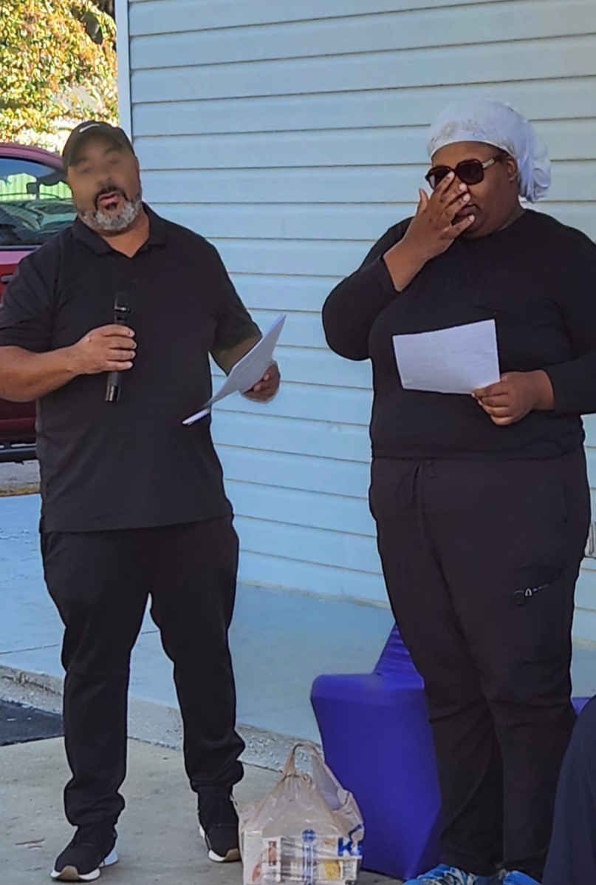
When it’s come to nutrition, we were pleased to have two, outstanding people before our group. Executive Chef, Rob and Chef Lindsey spoke on the importance eating healthily and provide resources for our members at Sunshine Inn.
Nutritional Health -

Slide 9
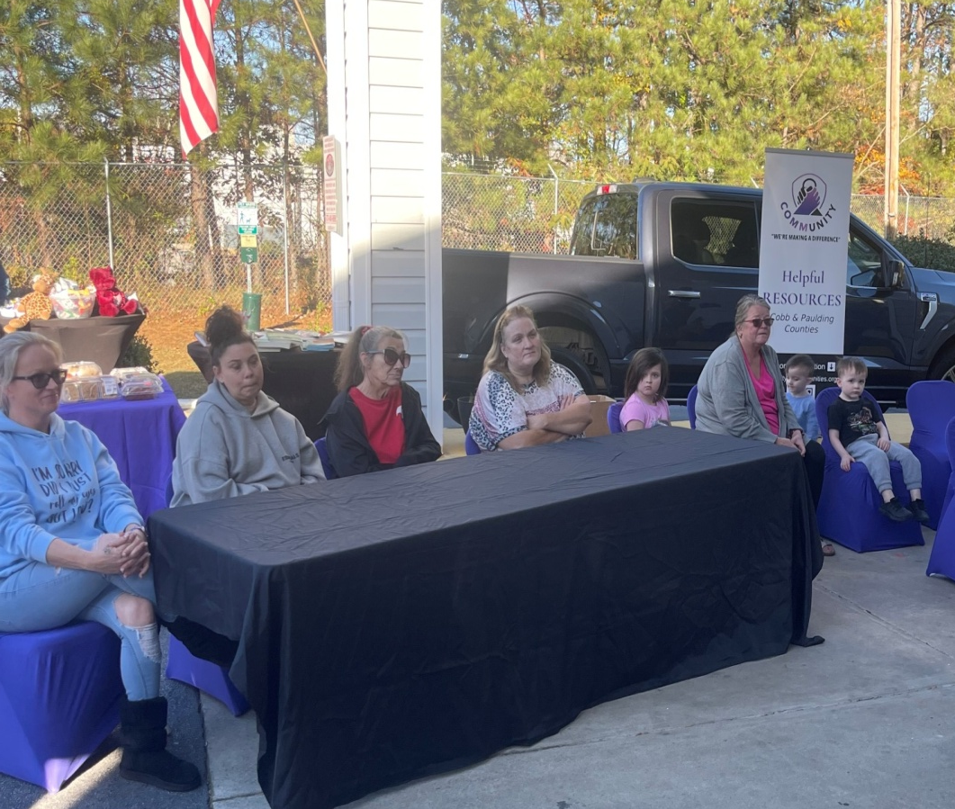
Members of the group at Sunshine Inn listen attentively, as our speakers help them understand there hope for all. Our guest speakers had the opportunity to address the group on various topics during this session.
The People -

Slide 10
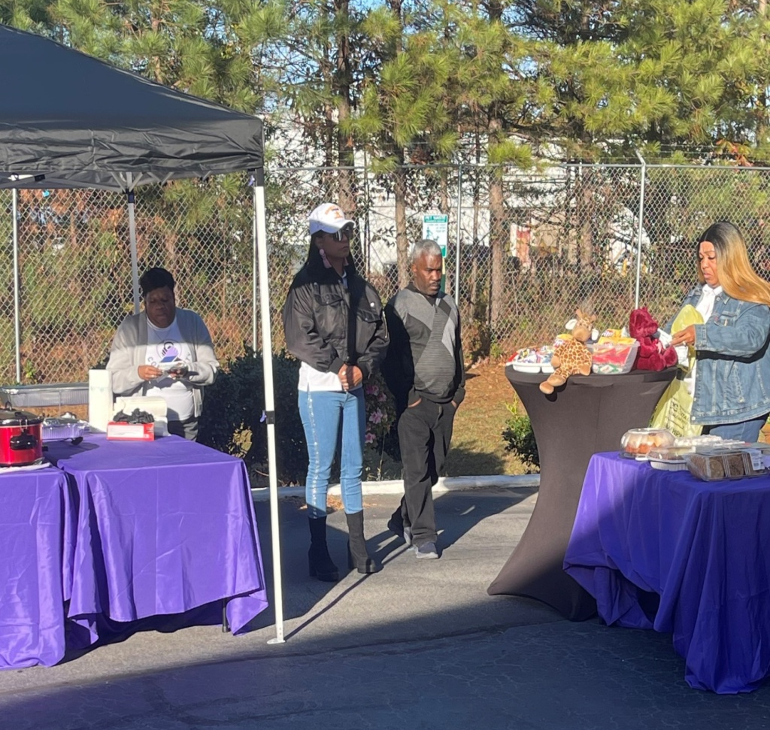
Members of our support group get ready to serve a hot meal to the members of our group at Sunshine. We want to thanked the members of COMMUNITY for taking time out of their busy schedules to assist in this event.
Our Support Group -

Slide 11
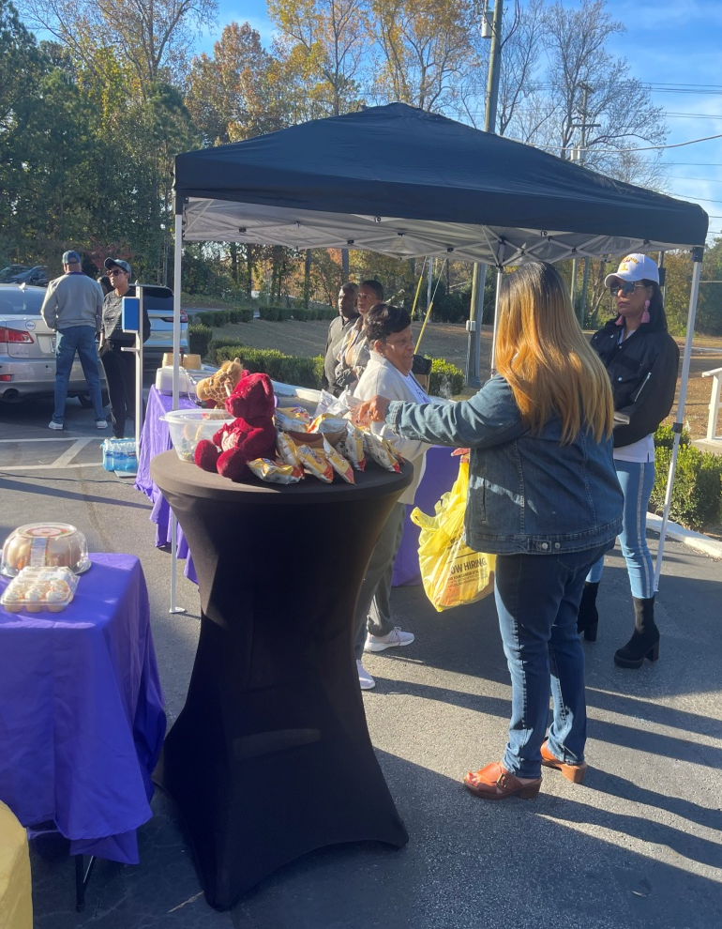
Hospitality is a key component in the outreach program. Providing good food, entertainment, and support help with the process. COMMUINTY’s support at our events have been paramount!
Our Support Group -

