Slide 1


T.R.I.A.G.E.
Tactical Response In Aiding God’s Endangered
Helping the ones in need -

Slide 2

Don't move the mountain just give me the strength to climb.
Focusing on the ones in need -

Slide 3

Focus on the use of resources. TRIAGE will help people get the resources they need to
help insure a better way of life. Putting God first is the key to helping those in need
in our community.
Focus #1 -

Slide 4
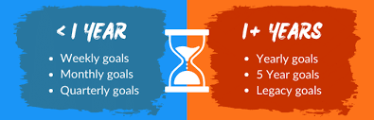
Focus on setting short-term and long-term goals. Where do you want to be in 1 year and 3 years? Our team will help guide families through the process of finding resources to help them begin the road to recovery and leave behind their survival mode.
Focus #2 -

Slide 5

Focus on mentorship. Partner with a mentor and develop to become a mentor.
Focus #3 -

Slide 6
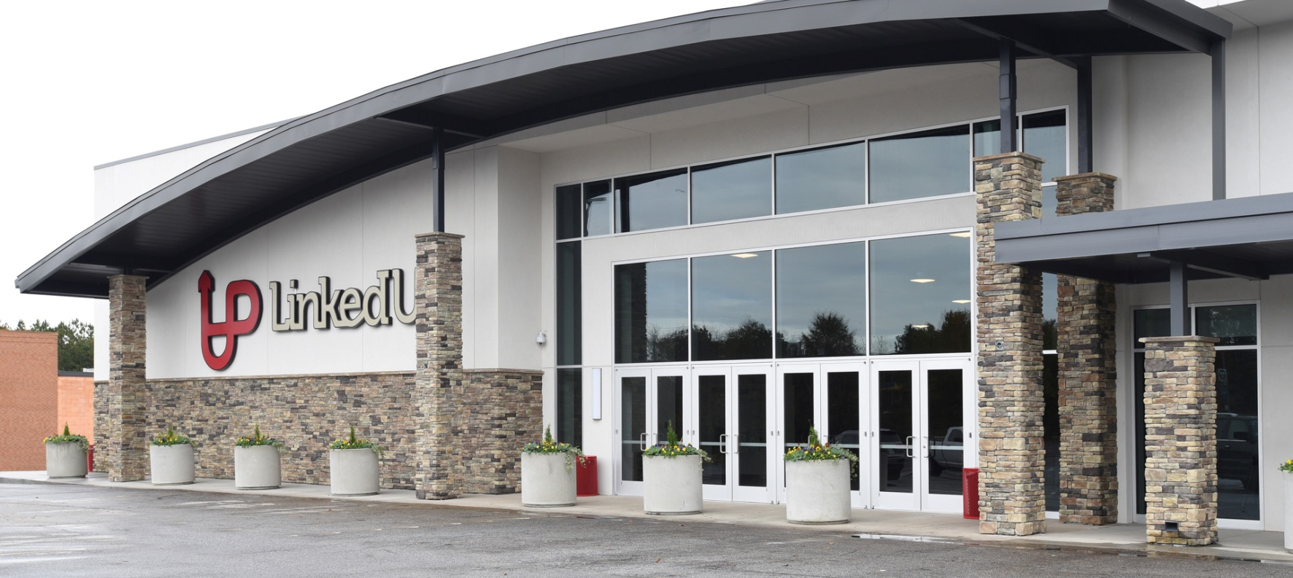
Focus on faith. Visit Linked Up Church
Focus #4 -

Slide 7




Focus on developmental activities. GED, job training, interviews skills, raise credit score, are focuses of our program to help people through tough times.
Focus #5 -

