Slide 1


T.R.I.A.G.E.
Tactical Response In Aiding God’s Endangered
Helping the ones in need -

Slide 2
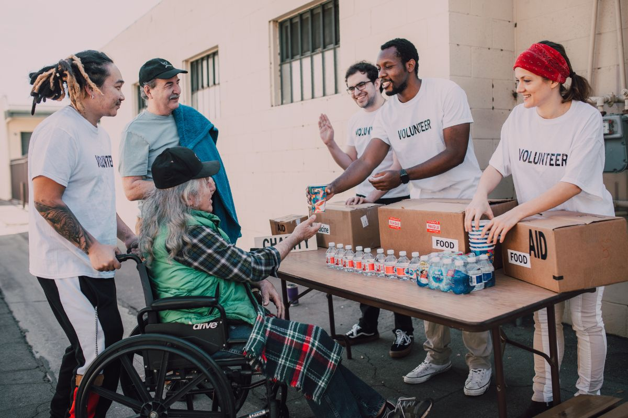
Place God first in our lives
Network in a transparent judgment free system
Be intentional in positive growth
Share & Encourage economic empowerment
Implement Professional & personal development
Provide Community support services
Mission -

Slide 3
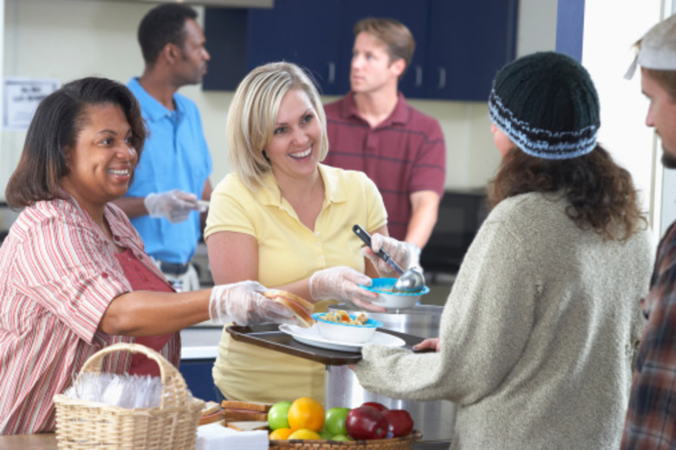
To empower and inspire breakthroughs and transformation through networking, sharing testimonies, being transparent and intentional with those who struggle in their walk of life, mental state, their fear outweighing their faith and wherever they feel weakened.
Vision -

Slide 4

Community engagement is paramount for our program to strive and help the ones in need. Social events at various shelters and extended stay properties will be our focus of care. Working with local properties managers will allow us to help families during process.
Purpose -

Slide 5
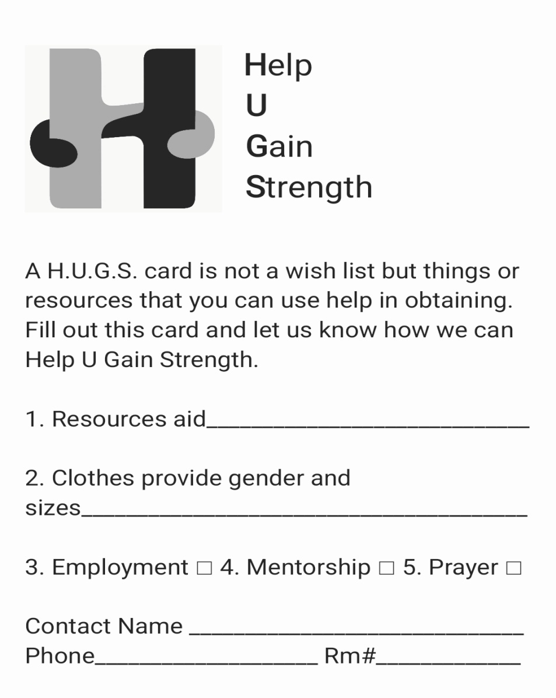
H.U.G.S -

