Slide 1


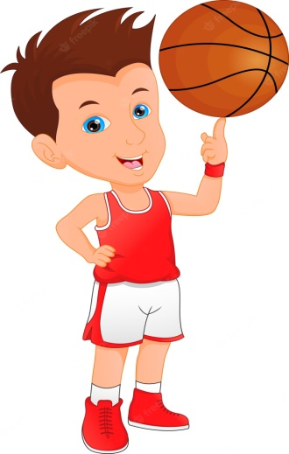
2026 - National Youth Sports Association
@
National Headquarters
Powder Springs, Georgia 30127
League Play Starts – Springs 2026
League Operation Information
“The Ultimate Basketball League for Kids”

Slide 2
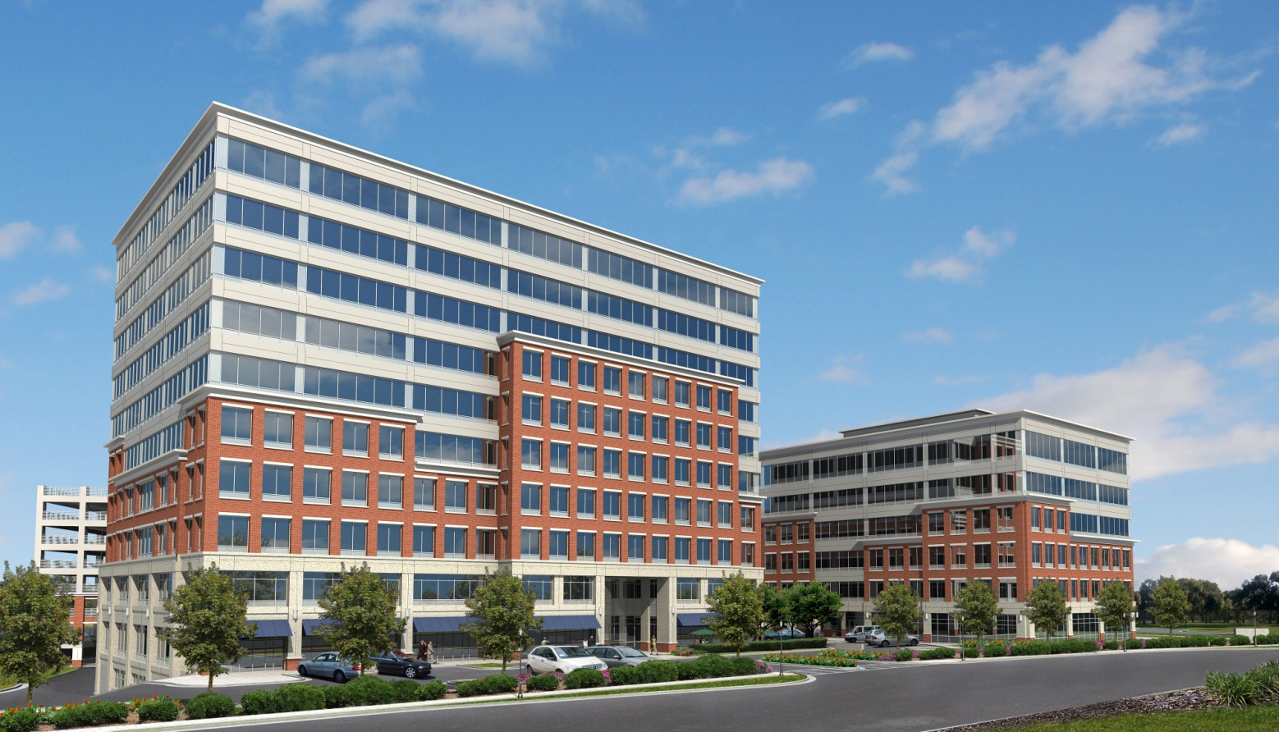

Ooooo
NYSA’s National office in Powder Springs, Georgia
National Headquarters -

Slide 3
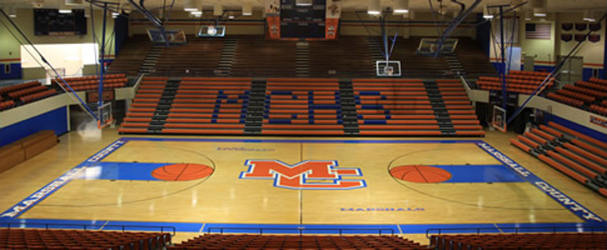
NYSA look to secure basketball facilities to conduct our league. Each city’s basketball facility will be offered funds for the use of the gym, along with all concession proceeds. A great way for a local high school basketball programs to fund raise during the off season and have your city’s teams continue to play and get better during the off – season. The facilities will be used for your teams home games!
- NYSA’s Game Facilities -

Slide 4
All teams are guarantee twenty - four (24) regular season games
Our league will cover the entire travel ball season from March - June
Teams will play two (2) games every week! League & playoffs games cover
f0urteen (14) weeks!
Coaches will receive Championship Rings for winning the Regional, State, and National Championship @ our season ending Banquet to honor all winning teams!
All games will be officiated by some of best officials that will be certified by the NYSA!
Some of most prestigious awards will be given out at the end of the season
Games will be played at various gymnasiums in each city. Teams that participate in the NYSA will play all their games at locations throughout the season
There are eight (8) NYSA Divisions – 16, 15, 14, 13, 12, 11, 10, & 9 under / Boys
The NYSA looks attract (1,100) teams in eight (8) states for it’s augural season. Florida, Texas, Georgia, South Carolina, North Carolina, Alabama, Arizona, & California!
- League Facts -

Slide 5
The NYSA will provide season ending Banquet tickets for all of our coaches & spouses at no charge
Regional, State, & National Championships Rings will be awarded for all winning
coaches in each grade division
Regional winning teams will be given funds to travel the State & National Championship tournaments.
All winning State Championship teams will be provide with new uniforms to represent
their city at the National tournament
The NYSA will honor teams with awards for winning the Regional, State, & National Championships
All game site staff members will be in NYSA league uniforms. The league will also provide all the
necessary game operation items and support staff at each venue!
The NYSA will form it’s own game officials organization for the league!
Officials will be certified by the NYSA!
The NYSA will provide athletic trainers, security officers, ticket attendants, video coordinators,
and a League Site Director at every game facility! Every game in the NYSA will be video taped and a copy of the game can be downloaded on our website for coaches’ & players’ review
The league will also provide a custodian at each game facility
The league will have the most interactive website to host all of league information including,
Game stats & videos, team & players information, league news, and much more!
- League’s Infrastructure -

Slide 6

The NYSA local staff will provide team & players’ registration for all teams. Players will fill out registration cards, receive their all – access badges, and rule kits. All coaches must attend an coaches certification class in order to coach on the bench in any NYSA contest. The NYSA’s, Executive Regional Director and Regional Administrator to work with teams to ensure a smooth transition throughout the season.
- Team Registration -

Slide 7
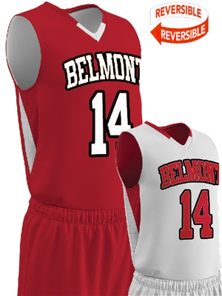
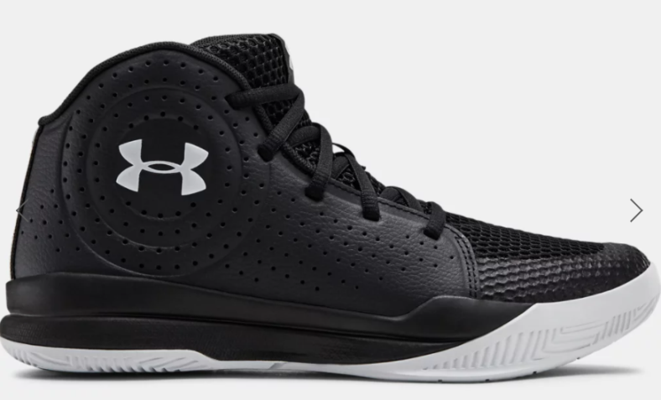
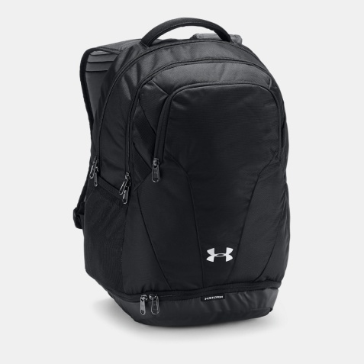
Each team will receive home & away reversible uniforms from the NYSA! Game shoes & team bags will also be provided by the league! Each team will be given uniforms
with their selected team color!
- NYSA’s Team Uniforms -

Slide 8
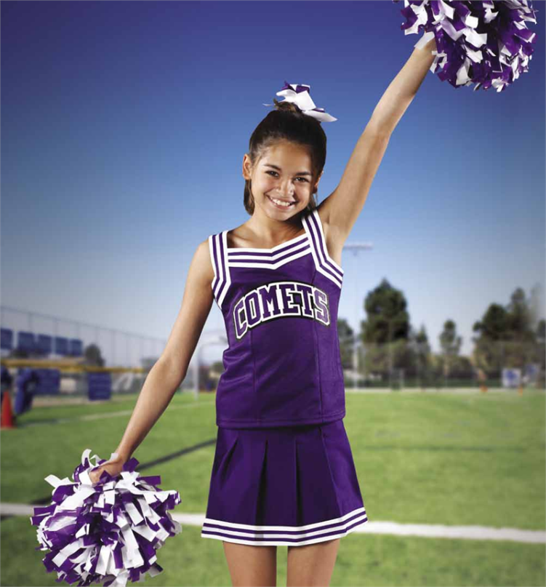
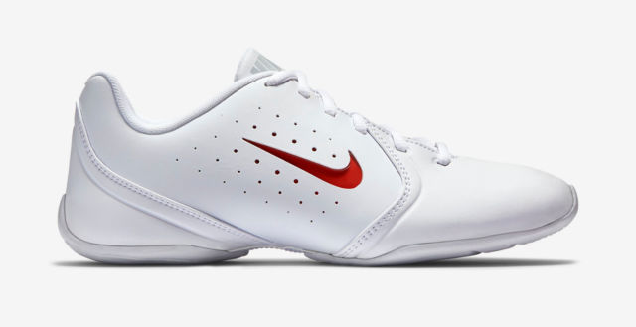
Each program cheerleading team will receive uniforms from the NYSA! Game shoes & bags will also be provided by the league! Each program will be given a team color & logo!
- Cheerleading Uniforms -

Slide 9
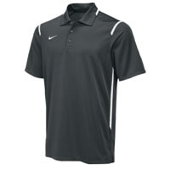
Each team coaches will receive uniforms from the NYSA! Coaches uniforms will have the team colors and must be worn at every game in order to be on the sideline! Coaches uniforms will include game shirt, pants, socks, and shoes to be worn during all league games
- Coaches’ Uniforms -

Slide 10
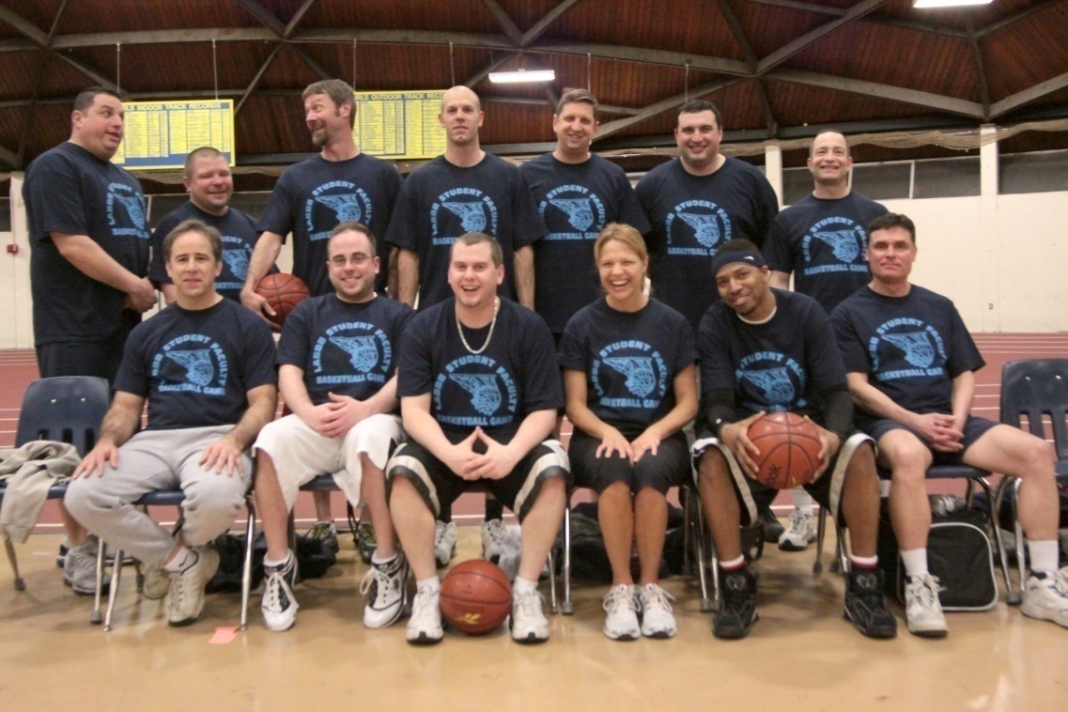
The NYSA will employ all of the game staff needed to run the event at each location.
Score keepers, time clock operators, site trainers, ticket takers, custodian, and league security will all be employed by the NYSA! All staff will be paid for their services by the NYSA. The NYSA looks to hired school’s staff or parents for these positions.
- Game Support Staff -

Slide 11
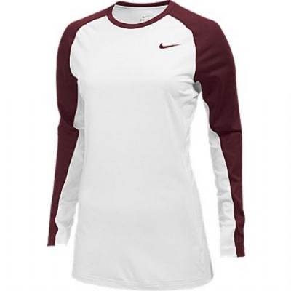
NYSA’s game operational staff will be given staff uniforms to wear at every game
facility within the league. Staff shirts are worn to identify league officials along
with their NYSA league badge.
- NYSA’s Staff Shirts -

Slide 12
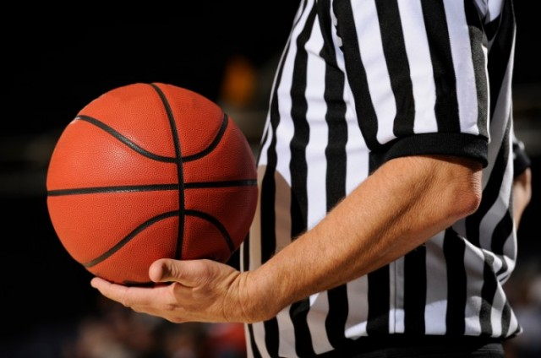
The NYSA will create their own officials organization that will officiate all of our league games. The NYSA will provide all of our officials with game jerseys, shoes, socks, and shorts with our NYSA logo!
- NYSA’s Game Officials -

Slide 13

NYSA’s Site banners, lobby posters, tickets, team signs, and standing sheets will be provided at every site during NYSA games! Home teams will provide concessions
and NYSA apparel will also be on sale @ every NYSA game site!
- Facility Marketing Items -

Slide 14
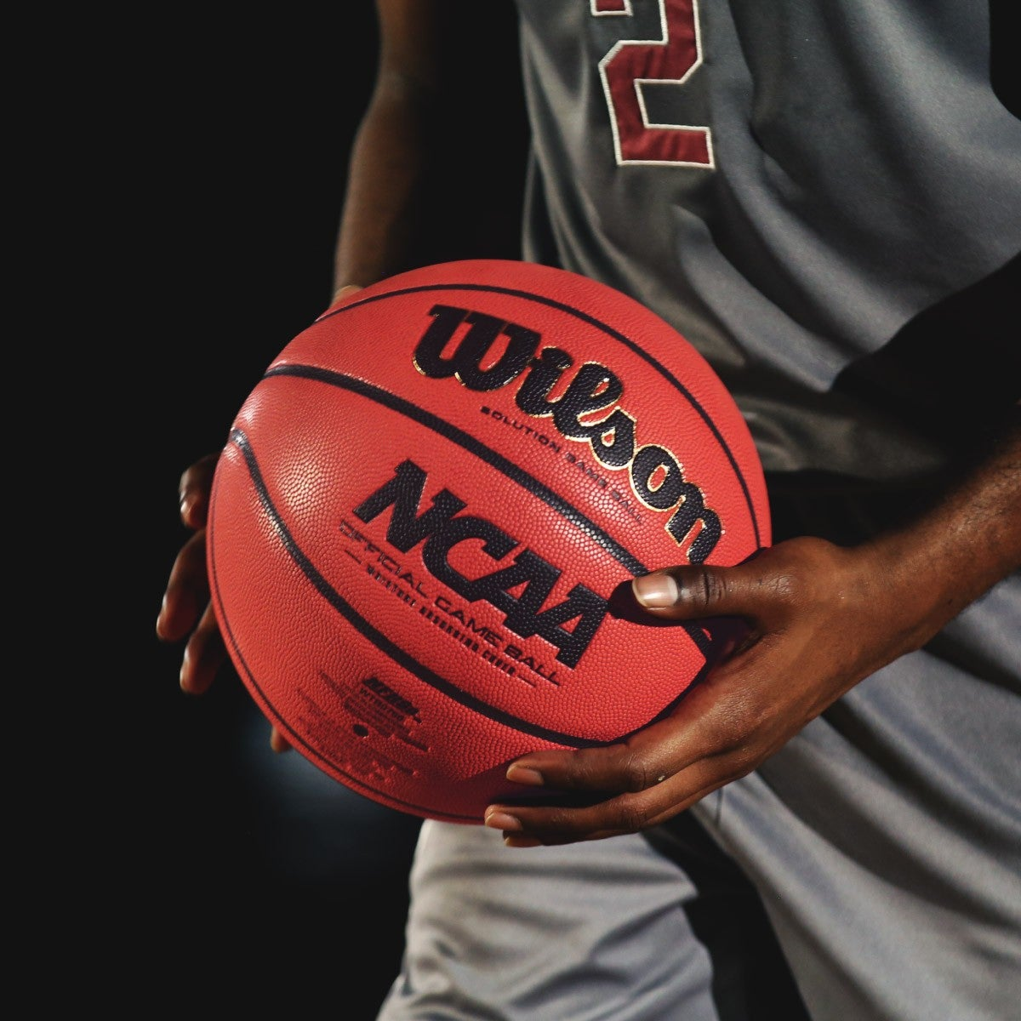
The league will provide game basketballs for each location. These balls are also property of
each NYSA, so road teams don’t need to bring basketballs to any game site! Twenty (20) basketballs will be provided to each franchise!
- Basketballs -

Slide 15
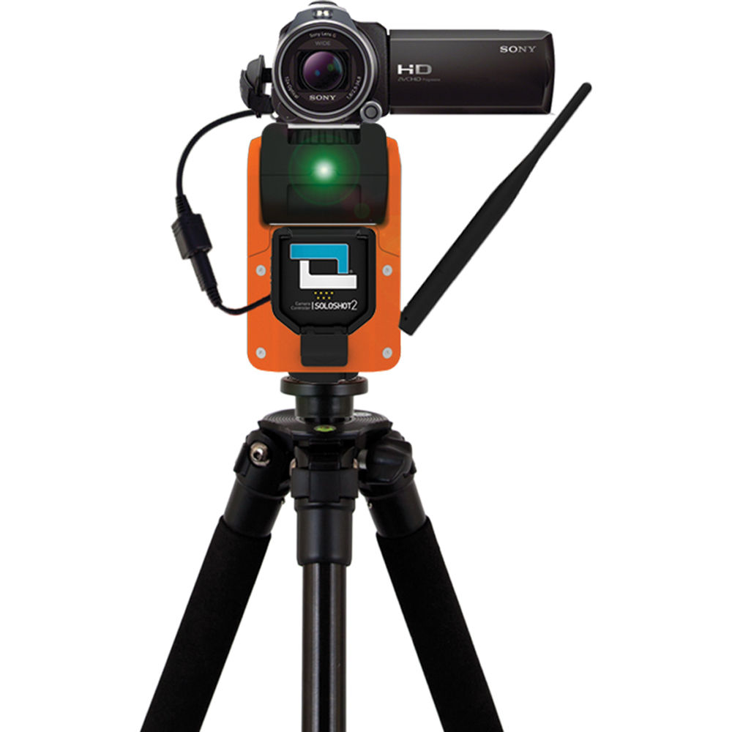
Every game in the NYSA will video! The NYSA will provide a Video Tech and a
game video will be provided to each team after every game. Also, games will be
loaded onto our league website. Also the NYSA will stream live top games each week from around the country!
- Video Team -

Slide 16
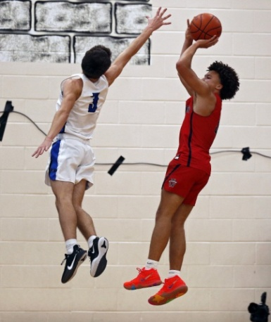
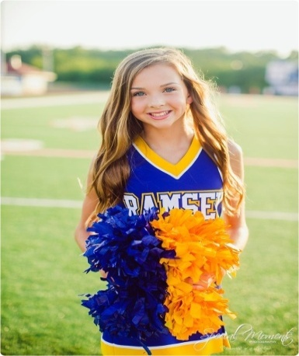
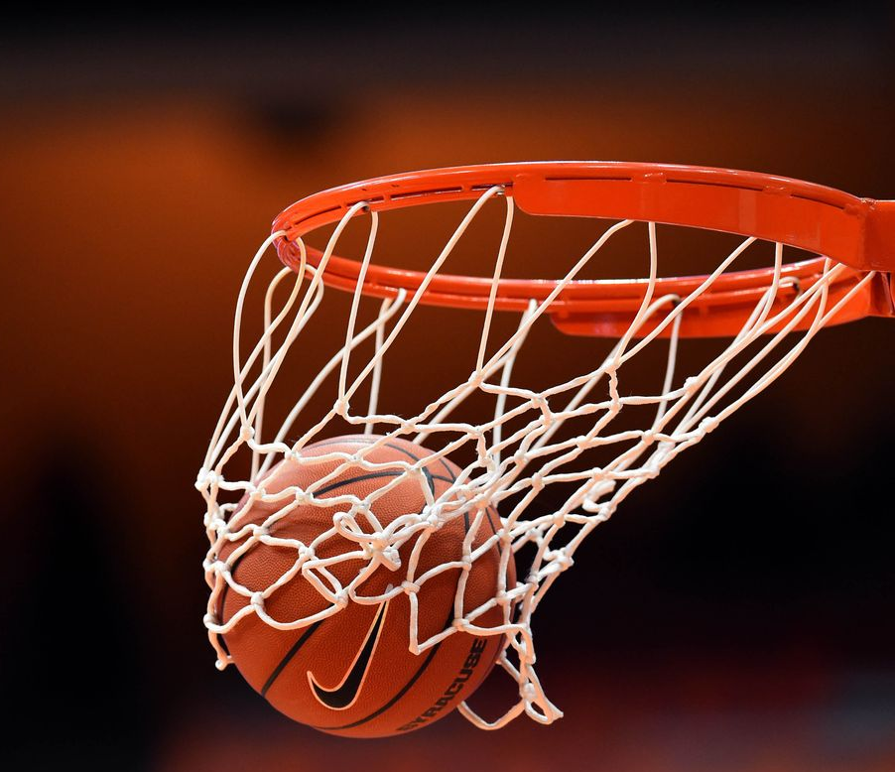
Program - Boys Teams
16 under – 10 players
15 under – 10 players
14 under – 10 players
13 under – 10 players
12 under – 10 players
11 under – 10 players
10 under – 10 players
9 under – 10 players
(8) – Boys Teams
Program - Cheer Teams
16 under – 10 players
15 under – 10 players
14 under – 10 players
13 under – 10 players
12 under – 10 players
11 under – 10 players
10 under – 10 players
9 under – 10 players
(8) – Cheerleading Teams
City Teams’ Makeup -
160 Kids / 16 Teams

