Slide 1


2026 - National Youth Sports Association
Players & Parent League Information
“The Ultimate Basketball League for Kids”

Slide 2

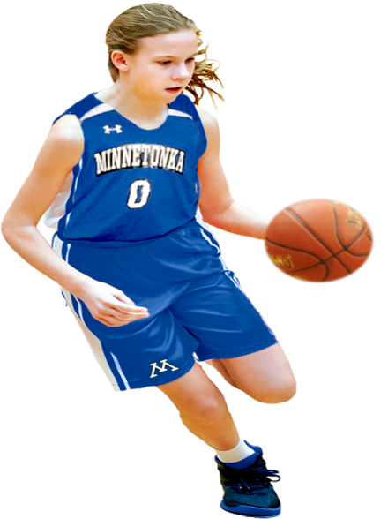
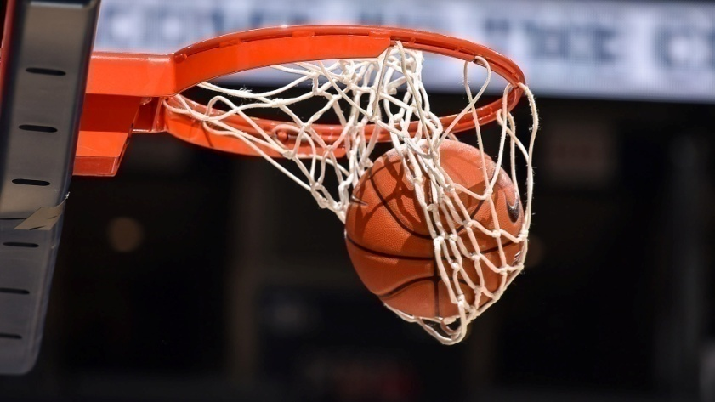

Local cities within several states will conduct tryouts in each community to make up their eight (8) teams to represent their community. Boys and Girls with all type of skills set
can tryout for the teams. Kids will go through various drills and game situation and coaches will selected their teams! Each team will play a twenty - two (22) games schedule
during the travel ball season!
* Welcome to the NYSA *
- City Tryouts -

Slide 3
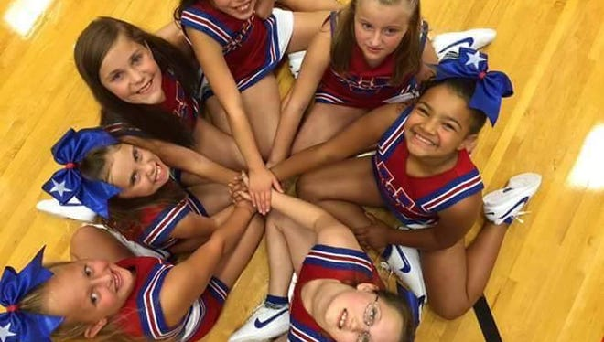
Cities will also conduct cheerleading tryouts in each city to make up their eight (8) teams to represent their community. Girls with any skills level can tryout for the teams. Cheerleaders will travel to all away games and will also travel to all playoff games with their respective winning teams!
* Welcome to the NYSA *
- Cheerleading Teams -

Slide 4
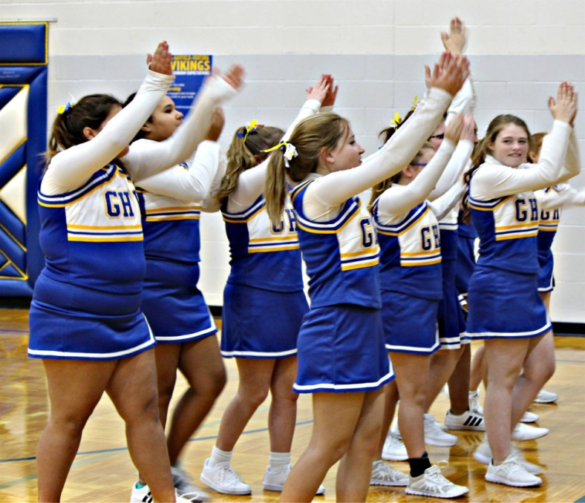
NYSA hold a season ending Cheerleading National Championship event to honor the best of the best! Each age group will be represented and all of our cheerleading teams will be invite to the event. Cheer and dance routines will be on display at the venue TBA
* Welcome to the NYSA *
- Cheerleading National Championship -

Slide 5
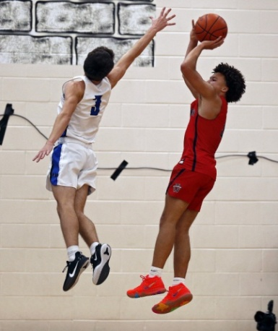
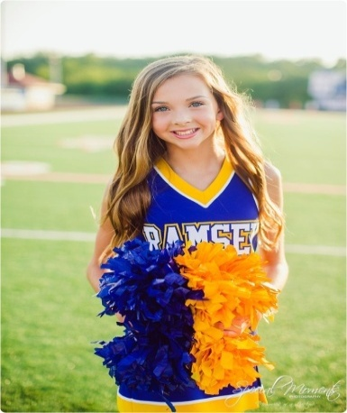
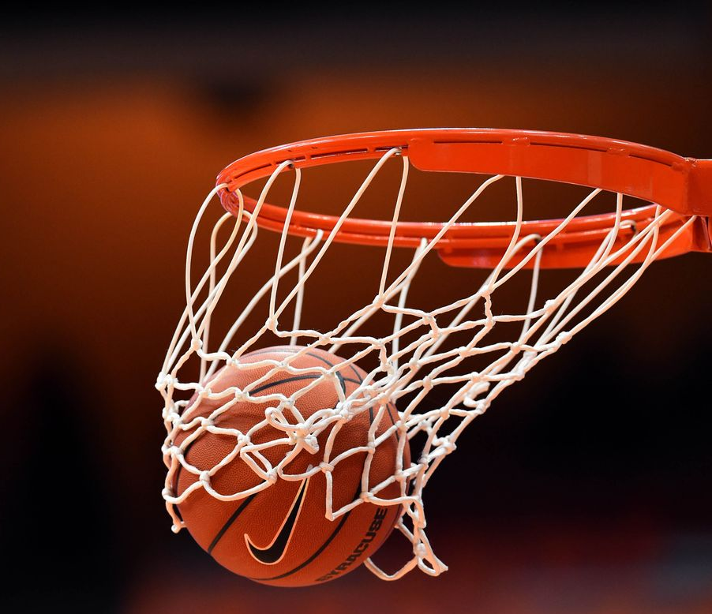
Program - Boys Teams
16 under – 10 players
15 under – 10 players
14 under – 10 players
13 under – 10 players
12 under – 10 players
11 under – 10 players
10 under – 10 players
9 under – 10 players
(8) – Boys Teams
Program - Cheer Teams
16 under – 10 players
15 under – 10 players
14 under – 10 players
13 under – 10 players
12 under – 10 players
11 under – 10 players
10 under – 10 players
9 under – 10 players
(8) – Cheerleading Teams
City Teams’ Makeup -
160 Kids / 16 Teams

Slide 6
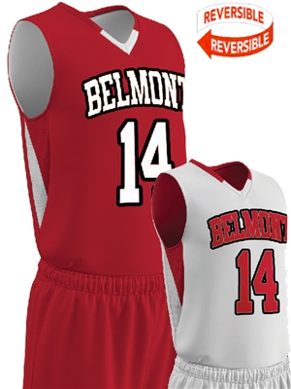
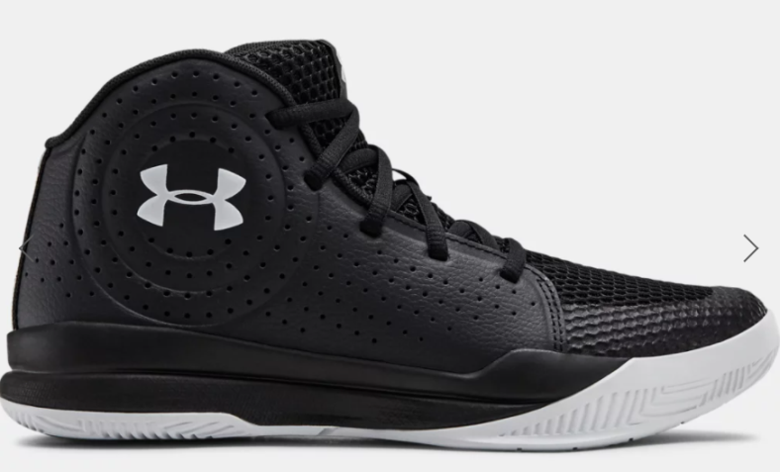
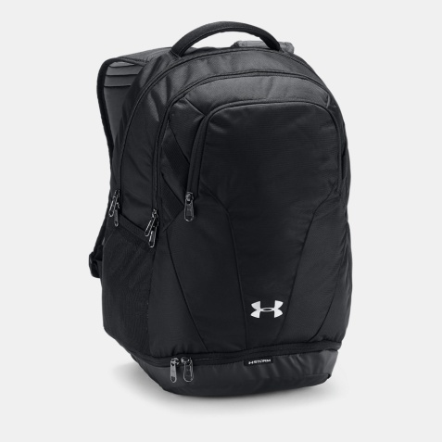
Each player will receive home & away reversible uniforms from the NYSA! Game shoes & team bags will also be provided by the league! Team uniforms will be given with their city’s respective team logo & colors!
- NYSA’s Players’ Uniforms -

Slide 7
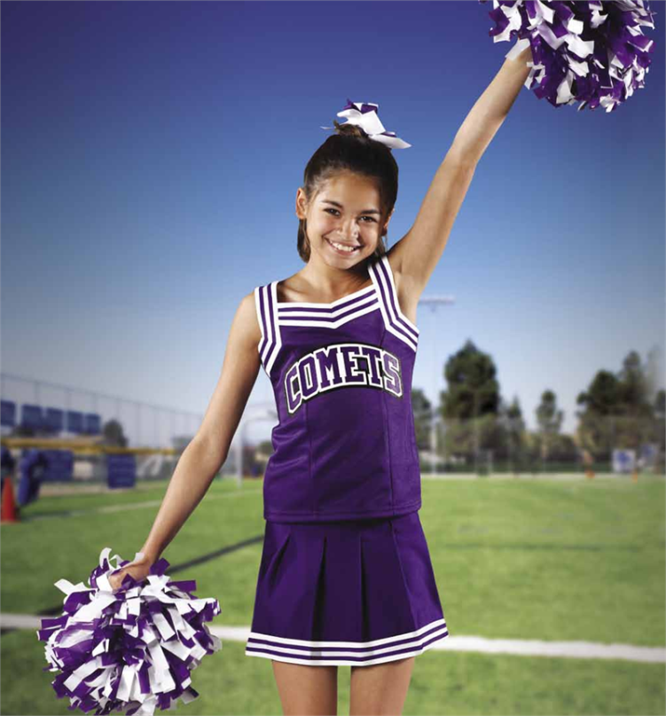
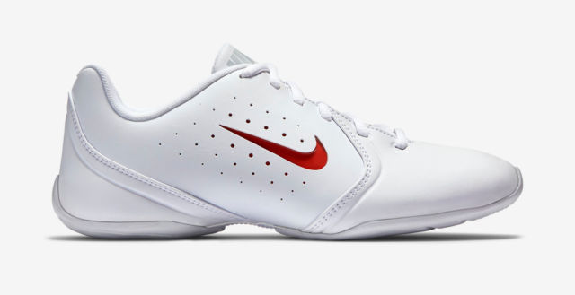
Each program cheerleading team will receive uniforms from the NYSA! Game shoes & bags will also be provided by the league! Each program will be given a team color & logo!
- Cheerleading Uniforms -

Slide 8
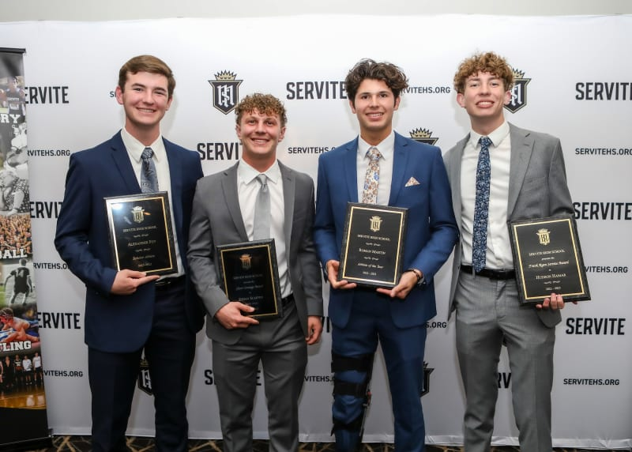
All of the players and coaches will attend the Players’ banquet at a site TBA
Also at the Players’ Banquet the NYSA will conduct a kids raffle
with lots of door prizes!
- Players’ Banquet -

Slide 9
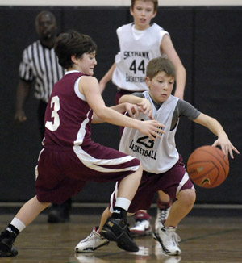
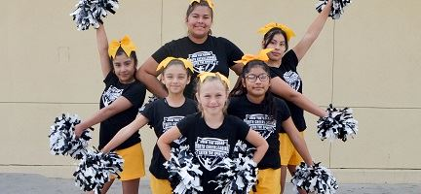
City - Club Information
Teams will play a (24) game - Spring / Summer Schedule
Players receive game uniforms, game shoes, & bags
Video tape games available on our website
Season Ending League Players’ Banquet
Team State & National Tournament Team Travel Stipend
League, State, & National Championship Awards
All league games are played locally within (30) miles radius
Players registration fees cover all cost for the entire season
Registration fees will be announce at Team Tryouts
Fund Raising is available to help with Players Registration Fees
- Players’ Registration Information -

