Slide 1


2026 - National Youth Sports Association
Team Championship Travel & Awards
“The Ultimate Basketball League for Kids”

Slide 2

Each County Division Champions winners will receive the following Awards;
Team Age Division – Regular Season Champions & Runner - up / Team Trophies
Team Age Division – Regular Season Champions & Runner – up / Players Plaques
All – League Team Awards – Top Fifteen (15) Players
Regular Season - Player of the Year
1st, 2nd, 3rd , & 4th Place / Tournament Team Trophies
1st, 2nd & 3rd Place / Tournament Individuals Awards
Coach’s Tournament Championship Rings & Plaques – Two (2) Coaches per team
Tournament - MVP
Program Director – Regular Season Overall - Team Championship Award
Each program will receive tickets for the league’s awards banquet
*** Please note all Coaches Championship Rings will be given out at the Award Banquet being held at a Hotel in each respective city / TBA
- Awards & Coaches' Banquet -

Slide 3

Each Regional Tournament Champions winners will receive the following Awards;
Team Grade Division – Regional Tournament Champions & Runner – up / Awards
All – Tournament Team Awards – Top Fifteen (15) Players
Regular Season - Player of the Year
1st, 2nd & 3rd Place / Tournament Individuals Awards
Players’ Tournament Championship Rings Plaques – Twelve (12) Players per team
League & Tournament – MVP
League Raffle winners will be announced at the Players Banquet. All of the players and coaches will attend the Players banquet at a school TBA
Also at the Players Banquet the NYSA will conduct a Players’ raffle with door prizes
- Players’ Banquet -

Slide 4

“Our National Championship Award”

Slide 5
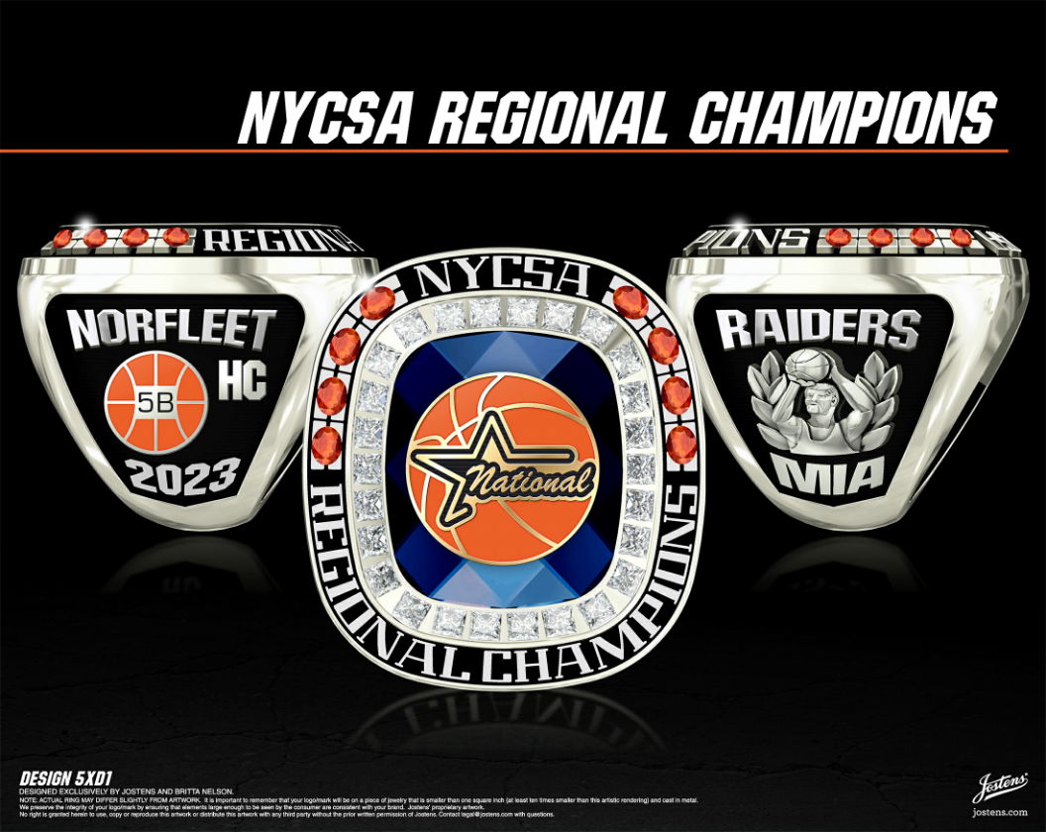
“National Youth Sports Association – Regional Championship Plaques”
“It gives us great pleasure to unveil our prestigious Regional Championship Ring designed
by Jostens Jewelers! League tournament winning players will be given ring plaques and
coaches championship rings in honor of their accomplishments during the regular season
- Regional Championship Ring -

Slide 6
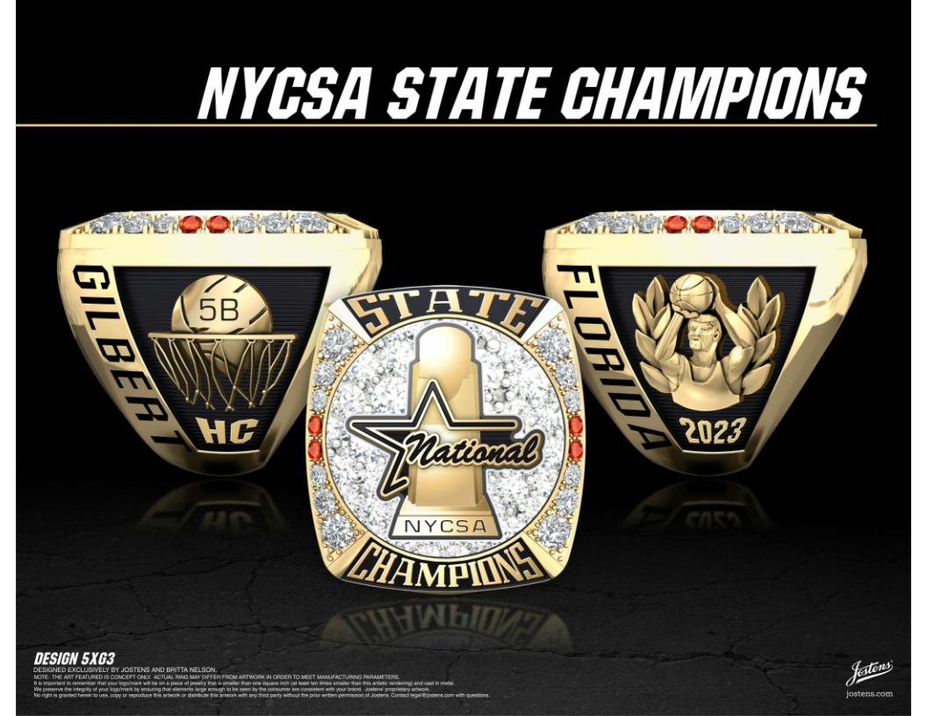

“National Youth Sports Association – State Championship Ring”
“It gives us great pleasure to unveil our prestigious State Championship Ring designed by
Jostens Jewelers! State Championship winning players will be given ring plaques and coaches championship rings in honor of their accomplishments at the Kids’ Banquet.
- State Championship Ring -

Slide 7
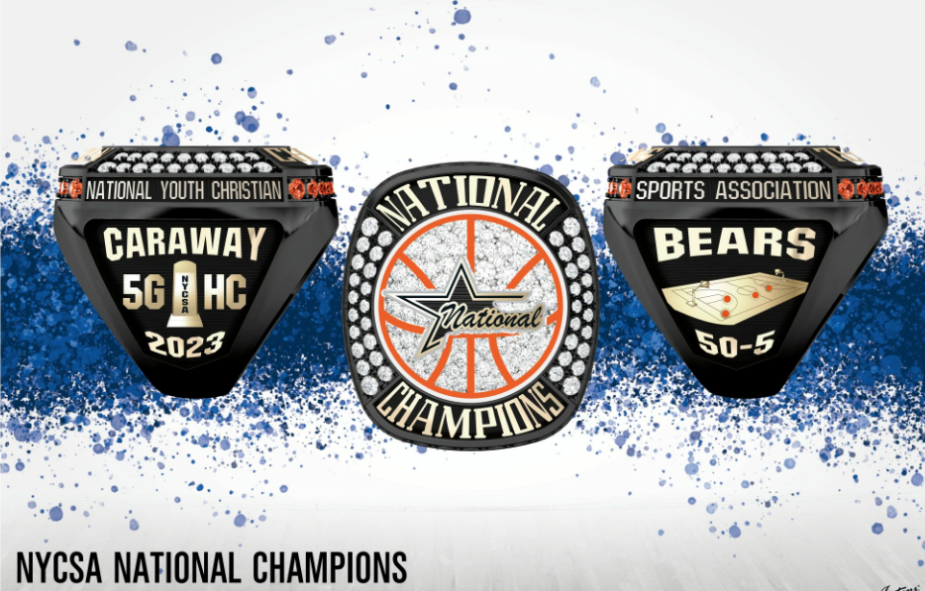
“National Youth Sports Association – National Championship Ring”
“It gives us great pleasure to unveil our prestigious National Championship Ring designed
by Jostens Jewelers! National Championship winning players will receive ring plaques & coaches will receive championship rings in honor of their accomplishments at the Banquet.
- National Championship Ring -

Slide 8

The NYSA will provide all funding for the Regional Champions to travel to the
State & National Championship tournaments. The league will also provide team uniforms
from each state championship team, so they will be represented at the national tournament.
Hotels and travel will be paid for by the NYSA! National Championships will held in Las Vegas
- Championship Team Travel -

