Slide 1


2026 - National Youth Sports Association
County League Directors’ – Job Descriptions
“The Ultimate Basketball League for Kids”

Slide 2

The National Youth Sports Association {NYSA} was developed to give kids around the nation the opportunity to play in a structured environment with a prestigious feel. With the help of dedicated youth coaches in urban areas around the country, the NYSA over the next four (4) years look to regionalize the country, so we can crown Regional & State Champions in both Boys & Girls divisions, in 32 states, leading up to the most prestigious National Championship tournament in the country, culminating with National Champions in each grade division! Just think that over two thousand (2000) cities coming together to form one of the best youth basketball alliances in the world. We know that the cost to travel limits organizations to play in tournaments each week, but with the birth of the NYSA, kids can play in our league over the travel ball season and get the feel of a real league format in the process! Our goal is to create sixteen (16) teams in each city, with sixteen (16) programs in each region! There are no sanction fees, just league registration fees for each child that plays in NYSA. As you read more about our organization, you will see, we are basketball guys, who understand the economics of the game, and look forward to providing one of the best products in the country. What make a league prestigious? Its organization, dedication, quality awards, great venues, top officials, support of local coaches and local government officials, and great kids! That’s what we’re all about, so come be a part of the basketball experience with the,
National Youth Sports Association!
- About Us -

Slide 3
The following Positions are available in each County
County Director
County Administrator – Registration & Schedule
County Administrator - Officials
County – Site Directors
- The Positions -

Slide 4

The National Youth Sports Association is seeking County’s – Executive Directors for the 2026 travel ball basketball season. The County Director for National Youth Sports Association (male / female) will assist with the management of the NYSA's youth basketball league at the local city level, which will provide a quality, safe, fun, and engaging youth sports experience for our participants. The County Director will help create & oversee the basketball & cheerleading operations & Booster Clubs in their respective area. Please refer to the State information tab on our website to find the city near you that you are interested in be coming one of our County Director and welcome to the NYSA!
- The Positions -

Slide 5
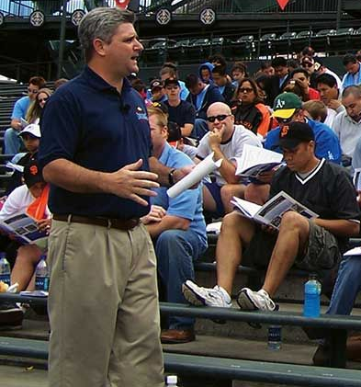
The County Director must have strong communication skills and has to be able to pass on and create information for the school’s program administrators. The County Director will oversee the entire area, which consist of over (3,000) players and coaches!
- County Director -

Slide 6

The County Administrator will oversee the teams and players’ registration, team compliance & league rules, manage their team’s home game experience, and be responsible for the distributing of teams’ schedules. The County Administrator will also coordinate teams travel logistics for tournament games.
- County Administrator -

Slide 7
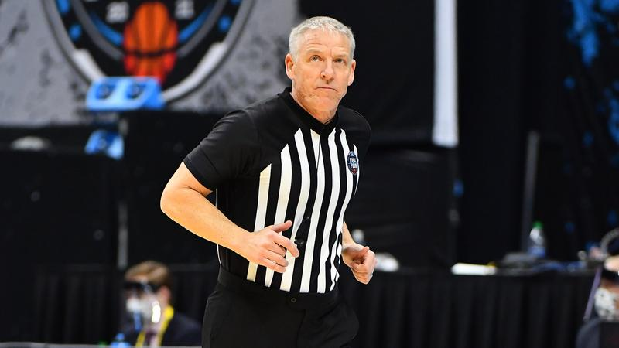
The County – Compliance Administrator will be responsible for game rules in their respective region. The Administrator will also oversee the assignment for all game officials at the regional level, along with training of all team directors on game day rules.
- County Administrator -

Slide 8
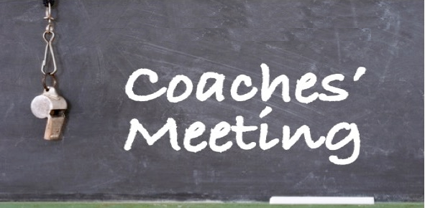
The County Director will hold bi - weekly coaches meetings (Basketball & Cheerleading) to update their staffs on any league or team news that is need to be conveyed to their respective coaching leadership in their program. The Director will assist & meet his / her administrative, game day, and booster club staffs when needed.
- Coaches Meetings -

Slide 9

The County Director will be the spokesperson media liaison for NYSA corporation at the city level. All comments, interviews, or press releases must be approved by NYSA legal team!
- Media -

Slide 10
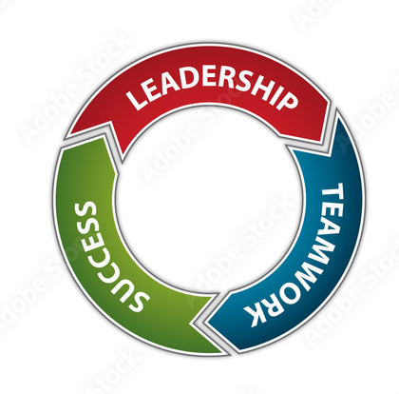
The County Director will work closely with the NYSA State & Executive Regional Directors within their respective regions to ensure the overall success of NYSA! Team work make the dream work, so let work together!
- Working Together -

Slide 11
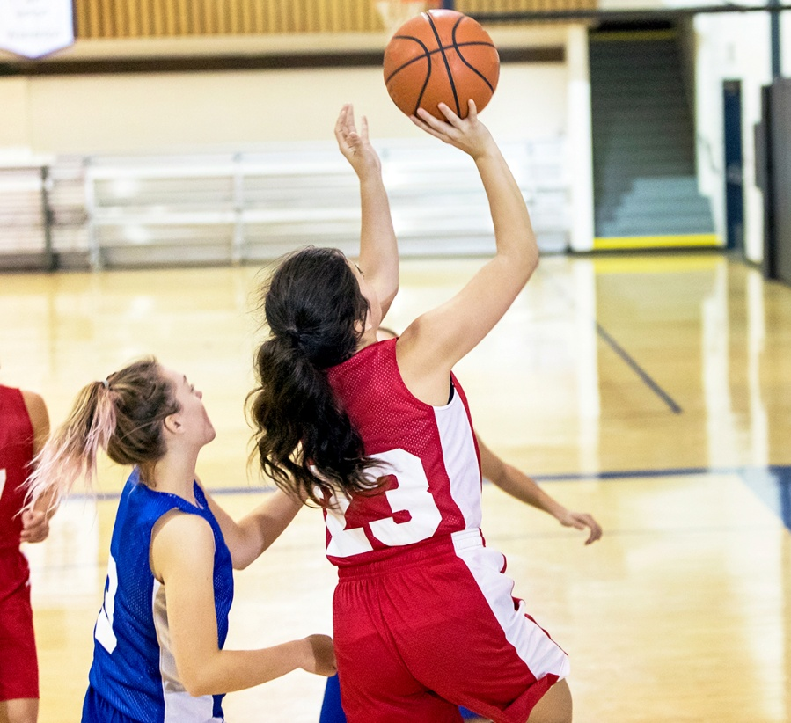
The County Director should have some knowledge, but not limited to the youth travel ball landscape at the lower & middle Schools levels in their respective area. Not having the knowledge, doesn’t prevent any person from applying for the County Director
position in any market!
- The Landscape -

Slide 12
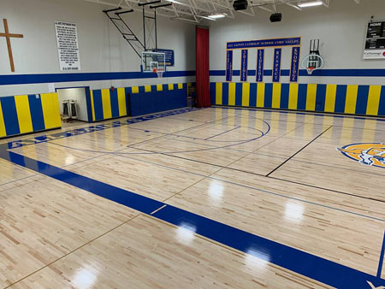
The County Director must be able to help the NYSA organization in securing teams for their basketball league within your respective county. Connections to middle schools coaches is also recommended and appreciated. This could also be a fund raiser for middle school basketball programs, as we have allocated funds for the use of their facility, but it also bring great awareness to their community by having the youth in their community playing basketball in their building during the off – season.
- The Connection -

Slide 13
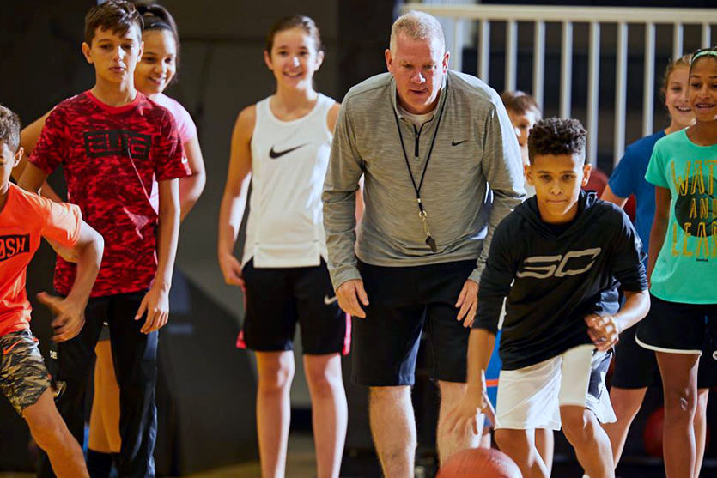
Passion for the game! The County Director must have a great love for the game and helping kids enjoy the sport they love! The Director must bring fun and commitment to the league that will set the tone for all of the organizations in their respective region!
- Passion -

Slide 14
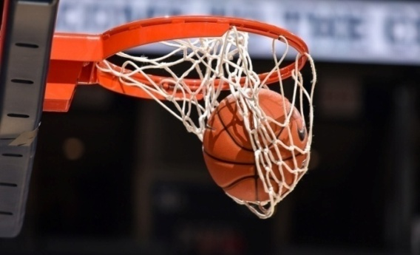
- County Director - Education and Experience -
1. Oversee the entire county’s basketball & cheerleading operations
2. Strong written, verbal, & computer communication skills preferred
3. Have an understanding of the youth travel ball landscape is preferred, but not necessary
4. Have a love for the game of basketball is a must! Must have the ability to work some evening and weekends when needed
5. This is a part time position, so having other employment is suggested
6. High school diploma is needed to apply for this position
7. Helping the NYSA gain access to a gym facility a plus, but not limited to applying
8. Youth, Middle and High Coaches, and Parents that live in their respective city are welcome and encourage to apply.
9. Must be able to pass a law enforcement background screening if selected for this position
10. Report directly to the NYSA – State Director
2026 – Season salary
TBA - (Part Time position) / (March – August)
- The Qualifications -

Slide 15
- County Administrators - Education and Experience -
1. Ability to maintain and engage in an extremely high level of customer service
2. Strong written, verbal, & computer communication skills preferred
3. Have an understanding of the youth travel ball landscape is preferred, but not necessary
4. Have a love for the game of basketball is a must! Must have the ability to work some evening and weekends when needed
5. This is a part time position, so having other employment is suggested
6. High school diploma is needed to apply for this position
7. Helping the NYSA gain access to a gym facility a plus, but not limited to applying
8. Youth, Middle and High Coaches, and Parents that live in their respective city are welcome and encourage to apply.
9. Must be able to pass a law enforcement background screening if selected for this position
10. Report directly to the County Director
2026 – Season salary
TBA - (Part Time position) / (March – August)
- The Qualifications -

