Slide 1


2026 - National Youth Sports Association
State – Employment Descriptions
“The Ultimate Basketball League for Kids”

Slide 2
The following Positions are available in each State
State Director
State Administrator
State - Basketball Administrator
State - Cheerleader Administrator
- The Positions -

Slide 3
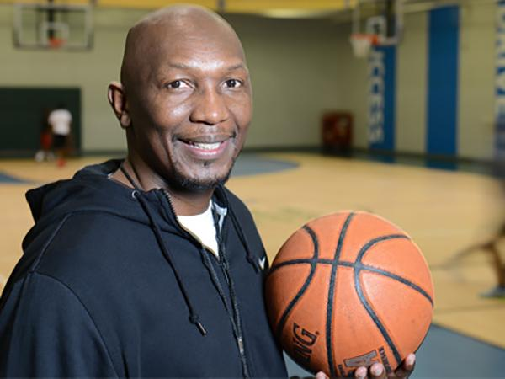
The State Director is responsible for the entire basketball and cheerleading operation in their respective state. The Director will oversee more than 25,000 players and over 2,000 coaches statewide. The State Director has to have a great understanding of game and have the ability to connect with all of the Executive Directors around the state! You need to love basketball.
- State Director -

Slide 4

- State Director -
1. Responsible for the basketball and cheerleading programs statewide
2. Strong written, verbal, & computer communication skills preferred
3. Have an understanding of the youth travel ball landscape is preferred, but not necessary
4. Have a love for the game of basketball is a must! Must have the ability to travel within their respective state when needed.
5. This is a part time position, so having other employment is suggested
6. High school diploma is needed to apply for this position
7. Helping the NYSA gain access to a gym facility a plus, but not limited to applying
8. Will oversee the state rankings for the entire state. Will certify all State Champions.
9. Must be able to pass a law enforcement background screening if selected for this position
10. Report directly to the NYSA – Chief Operations Officer / Regional Operations
2025 – Season salary
TBA - (Part Time position) / (March – June)
- The Qualifications -

Slide 5

The State Administrator will oversee the state’s administrative process, coaches certification records, players’ eligibility, and team compliance. The Administrator will also work closely with all the Regional Administrators to ensure the NYSA is running smoothly at the state level. The State Administrator will over see the State Tournament.
- State Administrator -

Slide 6
- State Administrator -
1. Will assist with the basketball and cheerleading programs statewide
2. Strong written, verbal, & computer communication skills preferred
3. Have an understanding of the youth travel ball landscape is preferred, but not necessary
4. Have a love for the game of basketball is a must! Must have the ability to travel within their respective state when needed.
5. This is a part time position, so having other employment is suggested
6. High school diploma is needed to apply for this position
7. Responsible for handling all the players, coaches, and administrators certifications
8. Will oversee the State Tournament in their respective state.
9. Must be able to pass a law enforcement background screening if selected for this position
10. Report directly to the NYSA – State Director
2024 – Season salary
TBA - (Part Time position) / (March – June)
- The Qualifications -

Slide 7
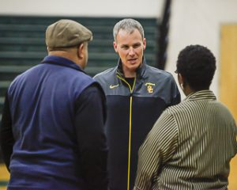
The State Administrator – Basketball Operations must have strong communication skills
and has to be able to pass on information to the coaches about the NYSA organization. Coaches of each community should be able to enjoy the experience of league along with their players, as each program will offer Basketball teams. This person is vital to NYSA league and the local level.
- State Administrator -

Slide 8
- State Administrator / Basketball Operations -
1. Ability to maintain and engage in an extremely high level of customer service
2. Strong written, verbal, & computer communication skills preferred
3. Have an understanding of the youth travel ball landscape is preferred, but not necessary
4. Have a love for the game of basketball is a must! Must have the ability to work some evening and weekends when needed
5. This is a part time position, so having other employment is suggested
6. High school diploma is needed to apply for this position
7. Will oversee and help all Basketball Coaches within the region with registration
8. Responsible for setting up certification & training classes for all coaches
9. Will oversee end of the season tournament play for the league
10. Report directly to the Executive Regional Director
2026 – Season salary
TBA - (Part Time position) / (March – June)
- The Qualifications -

Slide 9
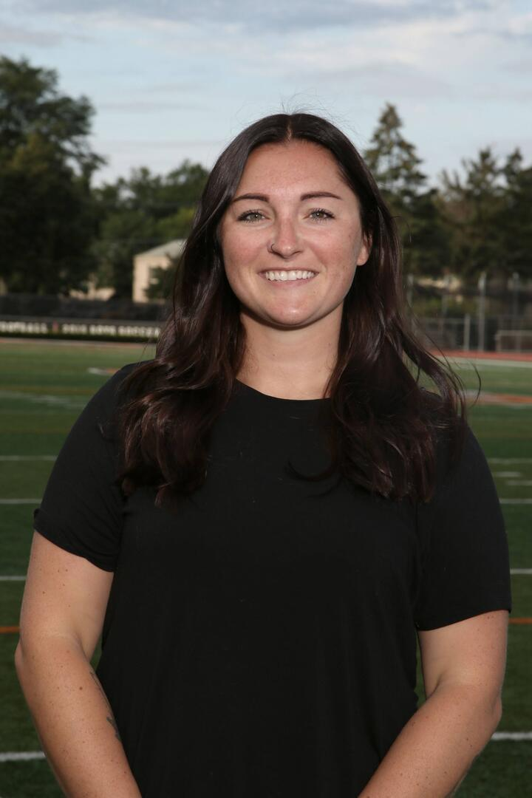
The State Administrator – Cheerleading Operations must have strong communication skills and has to be able to pass on information to the coaches about the NYSA organization. Coaches of each community should be able to enjoy the experience of league along with their players, as each program will offer Cheerleading teams. This person is vital to NYSA league and the local level.
- State Administrator -

Slide 10
- State Director / Cheerleading Operations -
1. Ability to maintain and engage in an extremely high level of customer service
2. Strong written, verbal, & computer communication skills preferred
3. Have an understanding of the youth travel ball landscape is preferred, but not necessary
4. Have a love for the game of basketball is a must! Must have the ability to work some evening and weekends when needed
5. This is a part time position, so having other employment is suggested
6. High school diploma is needed to apply for this position
7. Will oversee and help all Cheerleading Coaches within the region with registration
8. Responsible for setting up certification & training classes for all cheer coaches
9. Will oversee end of the cheerleading competition play for the league
10. Report directly to the Executive Regional Director
2025 – Season salary
TBA - (Part Time position) / (March – June)
- The Qualifications -

